Slide 1
Per Koch, The Norwegian Ministry of Education and Research and Jana Marie Mehrtens, the OECD
Governance of international co-operation on science, technology and innovation to address the global challenges of climate change, energy & food security

Slide 2
Rationale: Challenges of a truly global nature
Societies today are facing challenges of unprecedented magnitude
Most of these challenges are of a truly global nature; individual countries on their own are not in a position to produce solutions to issues such as…
These challenges urgently call for swift and efficient action
There has been growing political consensus that countries need to address them collectively
climate change
energy
global health
agriculture and food security

Slide 3
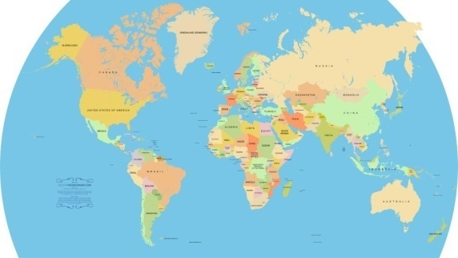
Why now? New global dimension of STI
In the past, global science, technology and innovation activities were mainly clustered in the “triad” (North America, Europe, Japan)
Recently new countries have appeared on the global STI arena: Brazil, China, India, Korea, South Africa etc.
Sustainable solutions for global challenges need efficient collaboration across national borders and involvement of developing countries
Multilateral co-operation in science, technology and innovation is urgently needed today.

Slide 4
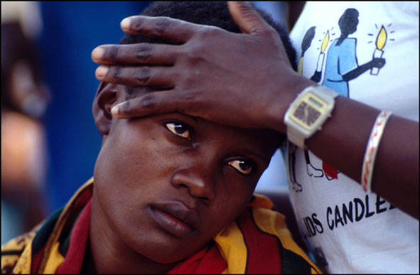
Why now? The role of science and innovation for global challenges
Current technology trajectories are unlikely to deliver on goals discussed by political leaders and called for by environmental scientists
Worldwide countries need to strengthen innovation and speed up scientific and technological progress in order to develop solutions to global challenges
Science, technology and innovation need to play a key role in:
understanding the interaction between various environmental, technological and social factors framing global challenges
developing solutions
assessing risks

Slide 5
Shortfall of existing policies and framework conditions
Existing policy frameworks and mechanisms that govern international co-operation in science, technology and innovation were created for different purposes and in different settings in the past and
… fall short of adequately supporting broad-based collaborative action at the scale and intensity required to tackle global challenges.
To facilitate international co-operation in STI, existing barriers have to be overcome and framework conditions conducive to multilateral STI co-operation need to be put in place.

Slide 6
Little knowledge of effective and efficient governance of multilateral STI co-operation
Hardly any consolidated knowledge regarding strengths and weaknesses of different institutional settings that support such co-operation
And no agreement or comprehensive mechanism is in place.
To deliver sustainable solutions
to global challenges
this gap needs to be closed!

Slide 7
What can governments do to help?
There is political consensus over the urgent need to improve the effectiveness of multilateral co-operation in STI across the globe in order to strengthen innovation and to facilitate and speed up scientific and technological progress to better collectively meet global challenges.
What does that mean, how can governments act
and what are the policy implications?
The OECD through its Committee for Scientific and Technological Policy (CSTP) has taken action to address this question and introduced:
Steering Group on Governance of International Co-operation on Science, Technology and Innovation for Global Challenges (STIG)

Slide 8
Project architecture
Analytical Work
Development of Recommendations
Setting the political and
methodological arena
Institutional case
studies
Analysis of governance dimensions
Conference
Scoping, drafting
principles
Negotiation and consultation
Analytical
Report
Policy
Recommendations

Slide 9
Case studies
The Group on Earth Observations (GEO)
The Inter-American Institute for Global Change Research (IAI)
The Consultative Group on International Agricultural Research (CGIAR)
The International Atomic Energy (IAEA)
The International Energy Agency (IEA) Implementing Agreements
Joint Programming Initiative (JPI) – Agriculture, Food Security and Climate Change (FACCE)
Bill and Melinda Gates Foundation
…and smaller case studies on The Global Carbon Capture and Storage Institute and The International Arabidopsis Genome Research Project

Slide 10
Analysis of governance dimensions
I
Institutional Arrangements,
Agenda and Priority Setting

Slide 11
Analysis of governance dimensions
II
Knowledge Sharing and
Intellectual Property

Slide 12
Analysis of governance dimensions
III
Funding and Spending
Arrangements

Slide 13
Analysis of governance dimensions
IV
Capacity Building and
Technology Transfer

Slide 14
Analysis of governance dimensions
V
Delivering Benefits:
Putting Science, Technology
and Innovation into Practice

Slide 15
What makes STIG special?
Scope goes beyond R&D and includes the delivery of solutions to society (accessibility and affordability)
Involvement of policy makers representing government perspectives from many parts of the world to reach broad political support for the final outcome of the initiative
To achieve tangible results and to do justice to the global dimension of the initiative, the involvement of developing countries is of particular importance
Works at the interface between research and policy making, drawing on experience from both arenas and involving collaboration and consultation with representatives and stakeholders from relevant fields

Slide 16
Lead countries involved
Australia, Austria, Germany, Chile, China, France, Israel, Korea, Norway, South Africa, Spain, United States and others
… and the European Union
CSTP is open to 34 OECD member economies as well as 4 observer countries

Slide 17
Expected outcome of STIG
clear understanding based on scientific analysis of what works and does not work in existing approaches
broad international agreement on the main principles and modalities for achievement and governance of multilateral STI co-operation to address global challenges
informing and contributing to deliberations in and efforts by not only governments but also other international fora in promoting multilateral STI co-operation for addressing key global challenges
building expertise and networks among participating countries from OECD and non OECD economies as well as with the private sector, non-governmental not-for-profits and other stakeholders

Slide 18
Workshop in Oslo May 18 to 20
The Oslo Workshop on International Co-operation in Science, Technology and Innovation to Address Global Challenges
Hosted by The Norwegian Ministry of Education and Research and the German Federal Ministry of Education and Research in collaboration with OECD and the Research Council of Norway as part of the Norwegian Year of Science
Experts, policy makers and stakeholders from all over the world to give advice and input to the STIG process.

Slide 19
Jana Marie Mehrtens
Policy Analyst / Economist
Organisation for Economic Co-operation and Development (OECD)
janamarie.mehrtens@oecd.org
Per M. Koch
Chair of STIG Steering Group
Norwegian Ministry of Education and Research
pmk@kd.dep.no
For further information please contact:

