Slide 1
Research Data and Infrastructures
A Funder’s Perspective

Slide 2
The German Research Foundation
Mission Statement:
The German Research Foundation (Deutsche Forschungsgemeinschaft, DFG) is the central, self-governing research funding organisation that promotes research at universities and other publicly financed research institutions in Germany.
The DFG serves all branches of science and the humanities by funding research projects and facilitating cooperation among researchers.
Notes:
The DFG is the central research council for Germany. It has a yearly budget of about 1,5 billion Euros and funds proposals form individuals, coordinated groups of researchers and institutions such as universities, libraries or media centers in a varioety of programmes.
The libraries group, the precursor of the present day scientific libraries and information systems group that is the active partner in knowledge exchange, has a long history at the dfg. After World War II, the exchange of scientific literature with other countries along with the systematic purchase of literature in all disciplines for German libraries was one of the most important activities of the DFG.
Strictly „bottom-up approach“

Slide 3
What is the issue?
Research Data ...
... are the basis of scientific findings.
... are inadequately used today.
... are accessible in a very limited manner.
... are not available on a long-term basis.
The Vision of the Research Councils
Research data should be freely accessible, they should be easy to get and they should be professionally curated on a long-term basis.

Slide 4
Let’s assume, ...
... secure storage and archiving, sharing and re-use of research data would be possible and it would be standard in science!
We would have many more data in a specific discipline and would optimise the research process.
We could compare very diverse data from other fields and would avoid duplicate work.
Data sharing would ensure quality control and other data sets could support own results and interpretations, new interpretations would be possible.
Own results could be acknowledged by other researchers.
Unique, non-reproducible results would be documented.
A free access to research data would ensure the standards of „good scientific practice“.

Slide 5
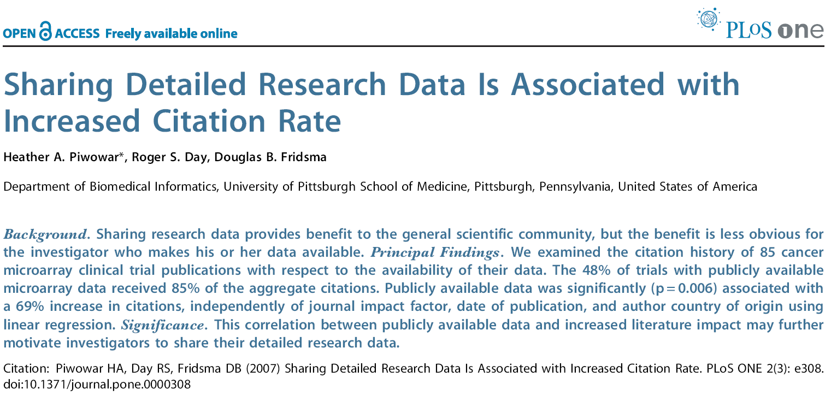
... and there is an incentive!

Slide 6
But, ... my data - my precious !
For scientists in many disciplines exist “very good reasons” not to share data, which may mean “giving them away”. A selection of quotes:
I have spent xxx Euro of my budget and yyy years of my work time to produce these data.
The data may be easily misunderstood.
The data could be erroneous and anybody else may discover this.
Somebody could find something interesting in my data.
Anybody could publish my data before I do.
It takes way too much time to understand and to format my data in the right context.
Where to and how could I deliver my data?
I fully loose control over my data.

Slide 7
Many open issues
Constitutional Freedom of Science: German Constitution § 5:
Does this include the freedom, NOT to share data?
Who owns the data?
Funding organisation, host institution, funding applicant, scientist, publisher?
How will data be provided?
What are the regulations for data re-use? Which licence model will be used? What are the incentives for scientists to share data?
(The availability of data not only is a technical issue …)
Quality control
Any data? What is possible, desirable and how? Who is responsible, which data where and how long should be archived?

Slide 8
The Alliance of German Science Organisations
The DFG together with:
Max-Planck-Society
Helmholtz Association
Leibniz Association
Frauenhofer Association
and others
22 June 2008: Priority Initiative
"Digital Information"
The main topics are:
National Licensing
Open Access
National Hosting Strategy
Research Data
Virtual Research Environments
Legal Frameworks

Slide 9
The German Research Foundation
1998: DFG „Proposals for Safeguarding Good Scientific Practice”
2003: Berlin Declaration on Open Access to Knowledge in the Sciences and Humanities
since 2007: workshops and expert round table discussions
2008: National priority initiative „Digital Information "of the Alliance of German Science Organisations
2010: GWK/Joint Science Conference by the Federal and Länder Governments
Commission on the Future of Information Infrastructure („KII“)

Slide 10
Recommendations for Secure Storage and Availability of Digital Primary Research Data
Committee on Scientific Library Services and Information Systems
Subcommittee on Information Management
January 2009
  Definitions of research data, organisational concepts, meta data and standards
  Keeping the rights of scientists and their interests in access to data
  Free availability on a trans-regional level
  Quality control
  www.dfg.de/lis/ at „Publications“

Slide 11
Research data management: approaches and strategies
Shaping and moderation of an awareness building process aiming at using digital resources more efficient, develop and implement appropriate infrastructures and tools and to finally make research data available (back up and archiving and re-use).
Close cooperation of scientists as data producers and providers to data repositories and also as users of those repositories with experts of the information management jointly shaping the process.
Define discipline specific demands and specifications and include these into the process.
Development of means for publication of research data (incl. peer-review).
Identify best practise examples and use experience.
Initiate pilot and exploration projects.

Slide 12
Current Activities
Supplement to the Guidelines for Proposal Preparation
(implemented at April 2010)
„ ... If during the proposed project scientific data will be gathered systematically, which may be feasible for later re-use, please describe the means how these data will be securely stored and made available for other scientists. Please regard the standards and the services of existing data repositories, if available in your specific scientific discipline … “
Call for proposals: Information infrastructures for research data
(call closed at the 28. April 2010)
In order to improve the long-term preservation of research data, the German Research Foundation (DFG) had issued a call for proposals for projects aimed at developing and optimising information infrastructures that seek to achieve an efficient and sustained use of research data. This initiative is administered by the DFG’s Scientific Library Services and Information Systems (LIS) division.
The German Research Foundation supports the systematic collaboration between scientists and information management experts.

Slide 13
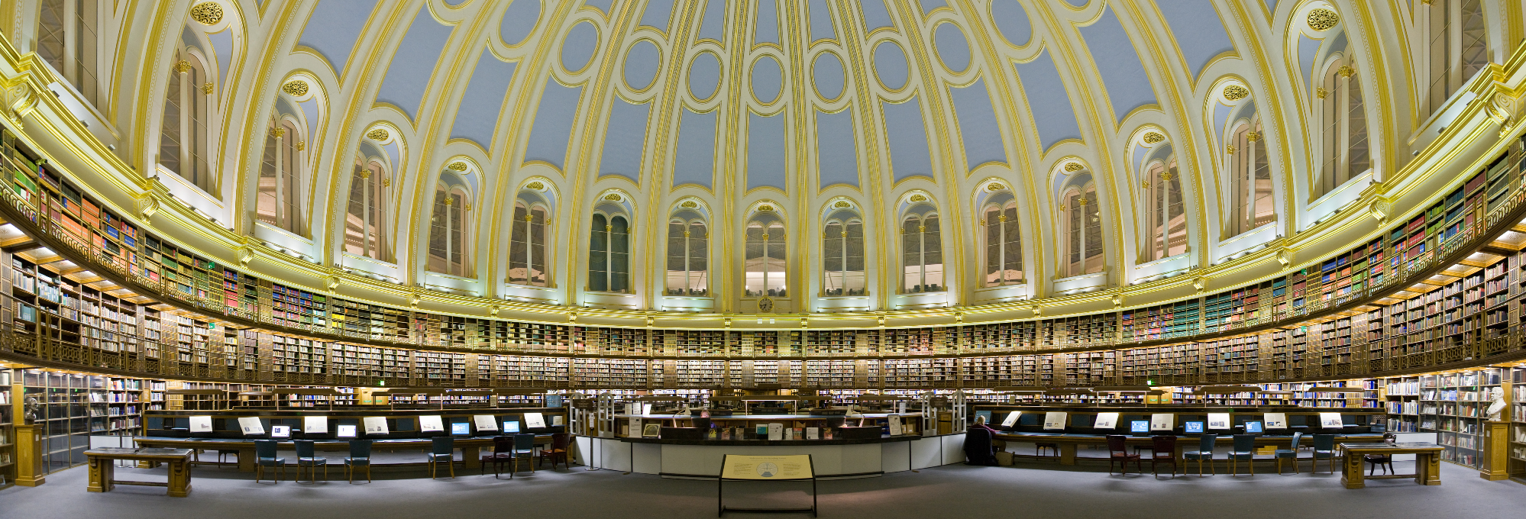
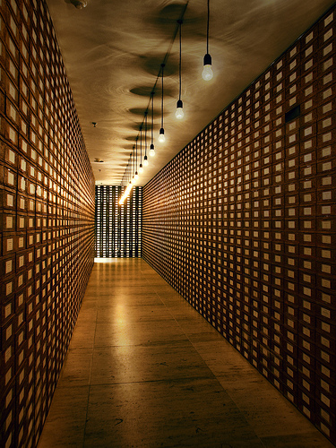
Information management experts? E.g. libraries, archives ...
Old Reading Room of the British Library, London
http://en.wikipedia.org/wiki/File:British_Museum_Reading_Room_Panorama_Feb_2006.jpg cc: by-sa
"Archive of the Members of the German Bundestag", a work of art by Christian Boltanski, in the basement of the Reichstag building http://www.flickr.com/photos/mr172/4451824642/: cc: by-nc-sa

Slide 14
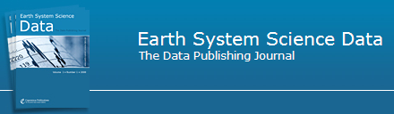
Data publications; e.g. ESSD
Earth System Science Data (ESSD) is an international, interdisciplinary journal for the publication of articles on original research data(sets), furthering the reuse of high (reference) quality data of benefit to Earth System Sciences. The editors encourage submissions on original data or data collections which are of sufficient quality and potential impact to contribute to these aims.
http://www.earth-system-science-data.net/home.html
Papers that pass a rapid access peer-review are immediately published on the Earth System Science Data Discussions (ESSDD) website. They are then subject to Interactive Public Discussion, during which the referees' comments (anonymous or attributed), additional short comments by other members of the scientific community (attributed) and the authors' replies are also published in ESSD.

Slide 15
What is on the agenda? A Summary
Think disciplines
  Define types of data, amount and characteristics, their specific life cycles and usage characteristics.
Encouraging the publication of data sets
  The willingness to provide access to data for scientific re-use should become standard in science and research
Legal regulations
Teaching and qualification
  Scientists and data curators
Working across sectors
Digital collections of scientific objects
Development and implementation of infrastructure
  Collaboration between scientists and information management experts
  Securing the interoperability of international and interdisciplinary networks

Slide 16
Thank you for your attention!
Stefan.Winkler-Nees@dfg.de

