Slide 1
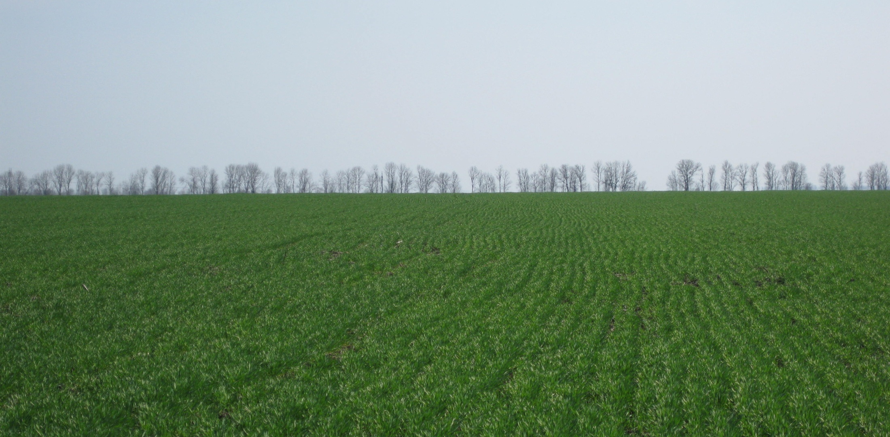
Improving the Linkages between the GEOSS Agricultural Monitoring Task and Science & Technology
Chris Justice
Inbal Becker Reshef
UMD

Slide 2
“ The goal of the session B4 is to review the current linkage between S&T communities and GEOSS, identify high-priority areas without sufficient links, and discuss steps towards improvements of links in these areas.”

Slide 4
GEOSS Ag Monitoring Task
(Co-chaired by USA -UMD & USDA, China- CAS, and EC-JRC)
Five main sub-tasks:
1) Global monitoring of agricultural production, facilitating reduction of risk and increased productivity at a range of scales;
2) Timely and accurate national (sub-national) agricultural statistical reporting;
3) Accurate forecasting of shortfalls in crop production and food supply;
4) Effective early warning of famine, enabling a timely mobilization of an international response in food aid; and,
5) Global mapping, monitoring and modeling of changes in agricultural land use, type and distribution, in the context of socio-economic and climate change.

Slide 5
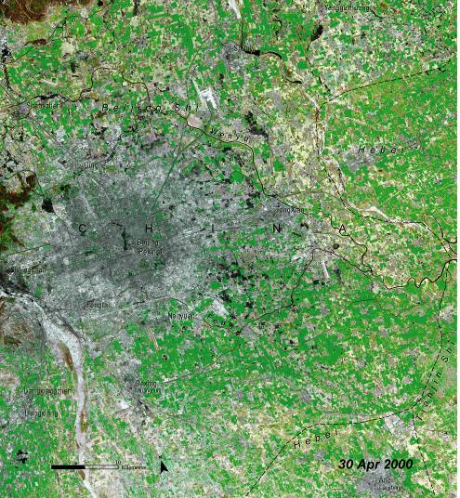
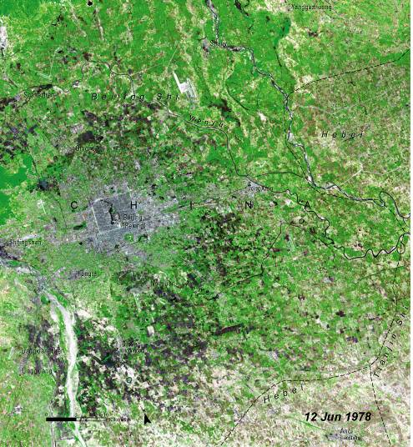
Agricultural Land Cover/Use Changes
Loss of Agricultural Land, Beijing China
Urban expansion
Beijing, the capital city of China, has experienced growth since economic reforms in 1979
1978: Beijing in 1978
2000: Extent of urban expansion is clearly visible
USGS /UNEP
Notes:
Beijing, the capital city of the People’s Republic of China, is located in the country’s northeastern corner, in the transition zone between the Inner Mongolia Plateau and the North China Plain. It is a city that has undergone tremendous change and explosive urban growth, since the start of economic reforms in 1979. The left-hand satellite image shows Beijing in 1978, just prior to the reforms. The light blue-gray area in the center of the image is the urban landscape of the city. The hills to the west are covered with deciduous forest, which appears green. The agricultural lands that lie around the city appear as muted red, orange, and golden yellow, depending on the crop (rice, winter wheat, or vegetables) and its stage of development. Beijing’s explosive growth is very obvious in the 2000 image. The city has expanded from its original center in all directions. Prime agricultural lands that once lay outside the city are now suburbs dominated by institutional, industrial, and residential buildings. In 2000, Beijing’s population was 13 million.

Slide 6
Agricultural Monitoring Systems Contributing to the GEO Community of Practice and Task Implementation
Most countries have a national agricultural monitoring system
Similar data needs, need for coordination and cooperation in sharing of data and methods inter-comparison

Slide 7
25 Countries producing over 80% of world crops

Slide 8
General Status
The GEOSS Agricultural Monitoring Community of Practice consists of both operational crop analysts/units and researchers/units (over 300 members representing over 40 national and international organizations)
Different national/international monitoring systems are at various stages of development and thus their S and T needs differ widely
Large disparity exists between developed and developing country capabilities
In general linkages are good in terms of the research community understanding S and T improvements that are needed for enhanced agricultural monitoring BUT pathways for transitioning proven methods from research to operations need to be strengthened

Slide 9
General Status
“Steps towards improvements of links in these areas”
Targeted user driven operational R and D needs to be explicitly supported for each operational monitoring unit
Augmentation funding to national operational monitoring units needed to support adoption for proven S and T
capacity building for developing country systems
Applied Research needs to be elevated in terms of its importance and funding
Community development of best practices guidelines for Agricultural Monitoring

Slide 10
Research to Operations
Fundamental
Research
Fundamental
Research
User Driven
Operational
Research and
Development
to support improved
monitoring
User Driven
Operational
Prototyping
Operational
Monitoring
Adoption

Slide 11
Immediate Research Needs: Sensors and Remote Sensing
Research is needed to:
Develop robust satellite-based systems and methods for rainfall estimation
Develop and validate satellite-based sensors and techniques for measuring and mapping soil moisture
Develop methods for fusion of optical and microwave techniques for monitoring crop growth, condition
Develop methods for enabling effective data inter-use so that data from the different international assets can be used interchangeably

Slide 12
Immediate Research Needs: Modeling
Improved end-to-end, coupled biogeochemical, hydrologic, and economic models to address the impacts, feedbacks, and costs of:
different agricultural land use change (e.g. extensification or abandonment)
different land use mitigation options to sequester carbon (e.g. conservation agriculture, no-till agriculture, shade cropping)
agricultural intensification and increasing fertilizer use
the trade-off between using crops for food or for biofuel

Slide 13
Immediate Research Needs: Modeling
Research is needed to develop and enhance:
Regional, spatially explicit, process models of land use change, to
project agricultural expansion, intensification, and abandonment
model the potential impacts of these changes on the major biogeochemical cycles, land-atmosphere exchange of water and energy and human population dynamics
Climate models that generate output at scales and with climate variables relevant to the key processes in regional crop models Modeling
for modeling agricultural productivity and change under climate scenarios
Data assimilation and modeling approaches for crop yield and production estimation
Better integrating EO with traditional methods for crop yield/production estimates
Reliable seasonal weather outlooks for risk assessment and management

Slide 14
Technology Needs
Infrastructure needs to include increased computational capacity to run higher resolution climate models with regional specificity and improved land surface satellite-based observations
Capacity building for integration of satellite data into operational monitoring systems in developing countries
Data delivery
Emphasis on near real time systems for monitoring
Ensuring data accessibility – including needs of developing countries

Slide 15
Priority Areas
Current Areas
Coordinated satellite acquisition over JECAM Test Sites (data policy – free and open sharing of site data)
Improved satellite based crop models
Robust global ET and soil moisture products
Develop best practices guidelines for ag monitoring according to cropping system
Better integration of monitoring capabilities into decision making processes
Capacity building – training the trainers
Establish funding mechanisms for implementation of CoP initiatives

Slide 16
Priority Areas
Near-term Priority 1–5 years
Automated global Landsat class land cover and land cover change mapping (science)
Develop and implement coordinated acquisition of international moderate resolution satellites for agricultural areas (technology)
Improve seasonal forecasts to achieve sufficient accuracy for use in agricultural management (science)
Integrated assessment modeling of food supply and demand, economic development and climate change scenarios to 2050 (science)
Establish baseline datasets including global: crop calendars, cropland distribution, field-size distribution, cropping complexity

Slide 17
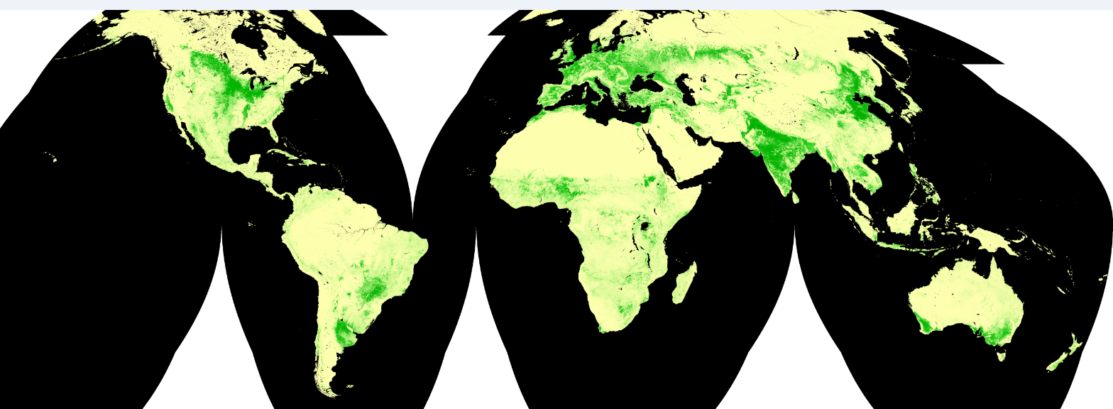
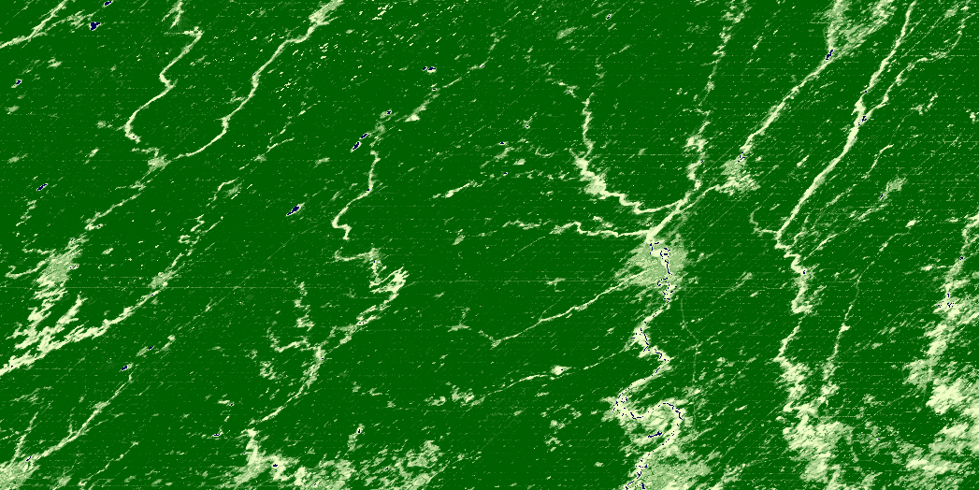
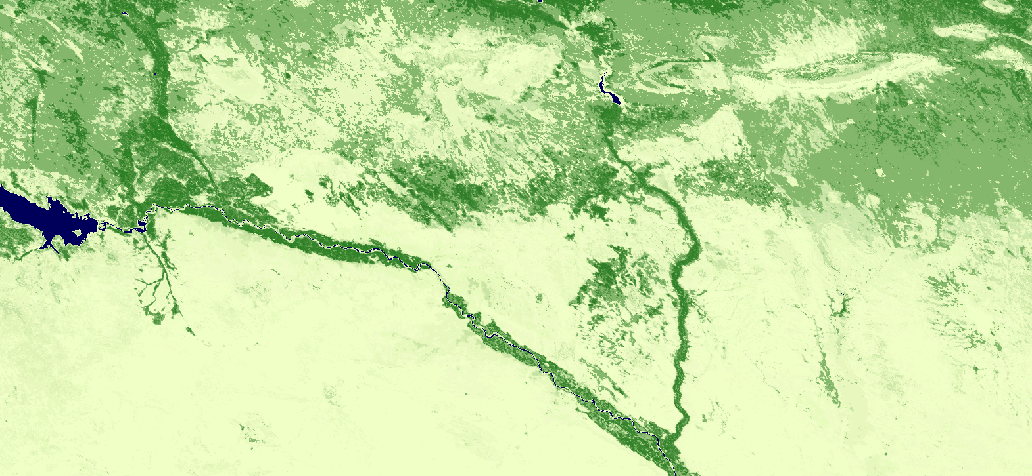
Global Distribution of Croplands by Cropping Intensity
Iowa
Syria
Hansen et al

Slide 18
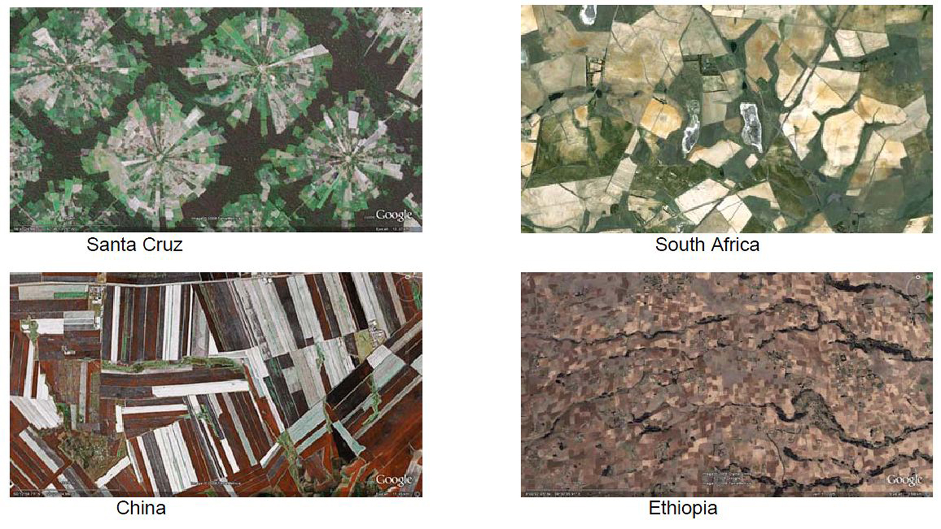
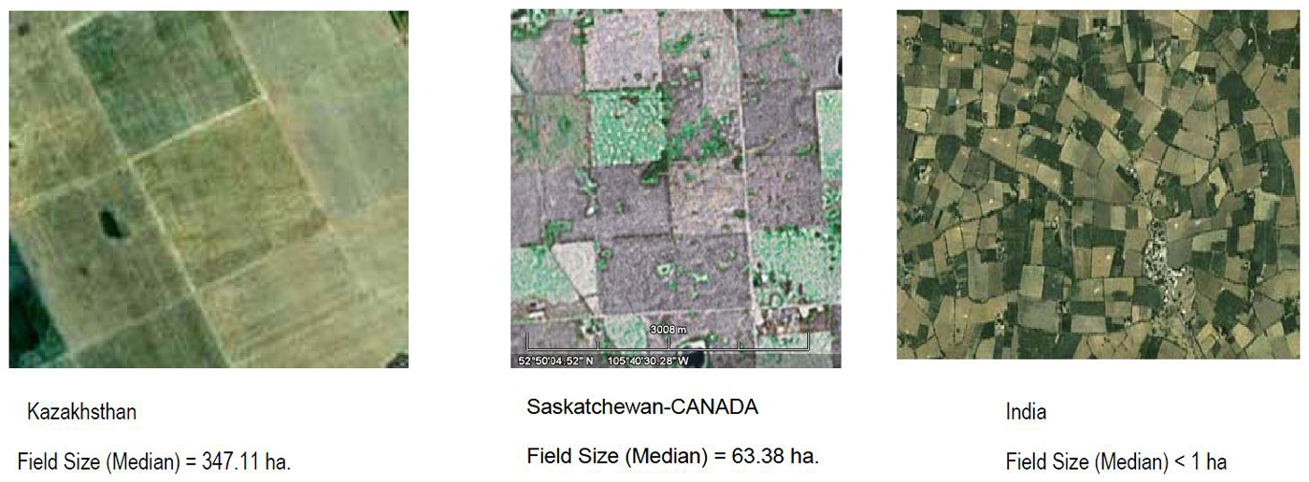
Large Variability in spatial complexity of cropping systems
Parihar, ISRO

Slide 19
Priority Areas
Mid Term Priority – 5 years
Develop and implement low-cost smallsat technology to provide 3-day global coverage with inter-calibrated optical (VisNirMidir sensors (15-30m) and easy access orthorectified data – establish operational sensor replacement through to 2025 (technology)
Develop and implement a connected global network of low cost ground-based radars covering major agricultural areas (technology)
Very low cost rain gauge network reporting rainfall amount via cell phone technology – implemented in Africa ( technology)

