Slide 2
GEOSS
National System
National System
National System
National System
National System
Congolese System
Indigenous System
Notes:
On vous a presente les connaissances de base sur les populations indigenes.
Vous voulez construire le systeme des systemes en vous basant sur les system nationaux entre autre.
Mais pour que votre systeme soit complet et universel il doit comprendre les connaissances de tous les peuples qui vivent sur notre terre.
C´est a dire les peuples civilises et les peuples autochtones.
Les autochtones ont une base de connaissances non utilisees.

Slide 3
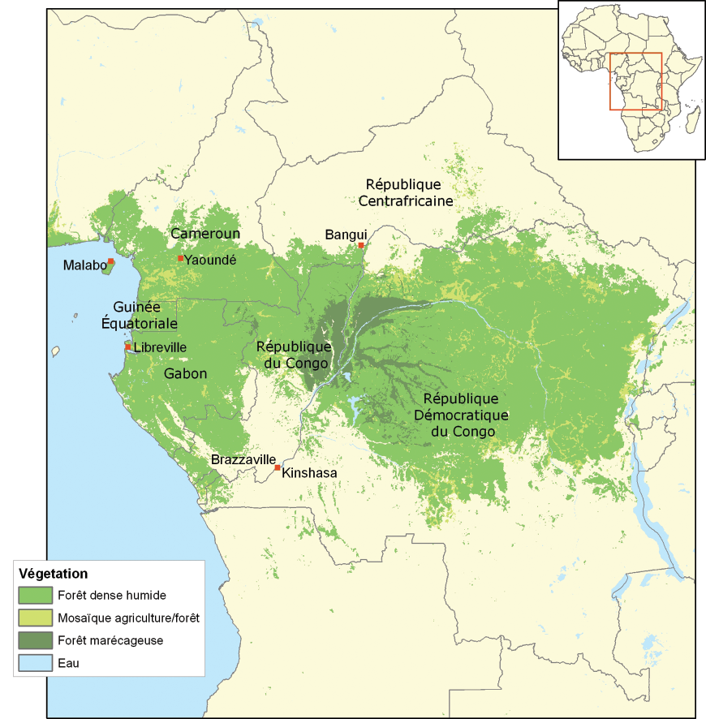
LES PEUPLES AUTOCHTONES DU BASSIN DU CONGO
Present in more than 10 countries of Central Africa
Burundi, Cameroun, Sao Tomé et Principe, Gabon, Guinée-Equatoriale, République Centrafricaine, République du Congo, République Démocratique du Congo, Rwanda et Tchad.
Diffrent names:
Aka (Congo, Cameroun, RCA) Mbuti (RDC), Baaka (Congo-Brazza), Bedzang (Cameroun), Bakola (Cameroun), Babongo(Congo-Brazza, Gabon), Twa (RDC), Mbororo (Cameroun, RCA, Tchad).
huge knowledge in the forest and its biodiversity:
cultures, essences forestières, plantes médicinales, espèces animales et ressources écologiques et biologiques locales.

Slide 4
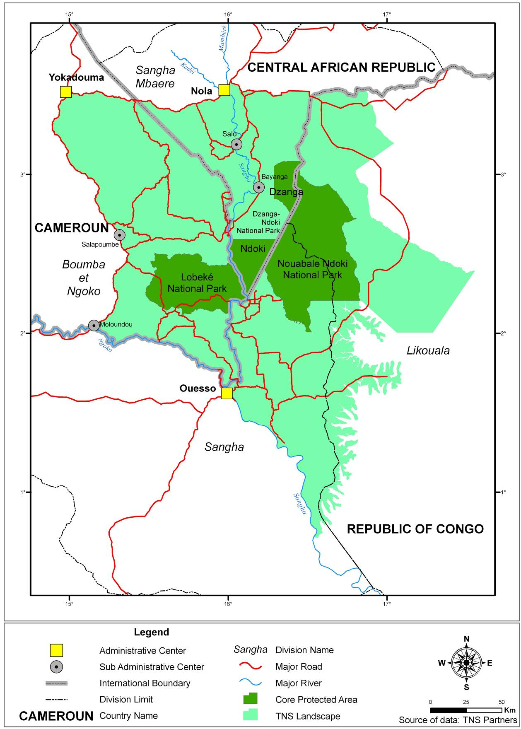
LA FORÊT DU BASSIN DU CONGO
The forest of the Congo Basin
ca. 200 mio ha coverage
- a treasure for mankind
Second largest tropical rain forest in the world after the Amazon Basin
Ecosystem services: direct benefits for 30m people

Slide 5
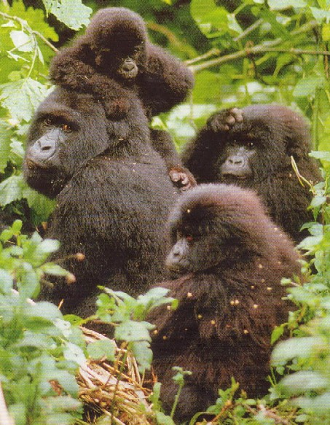
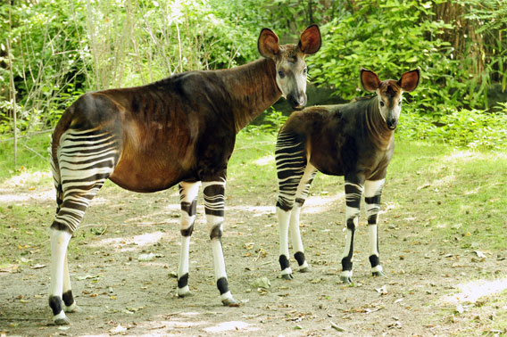
These Ecosystem services are directly linked with biodiversity. The forests of the Congo Basin are an important reservoir of biodiversity. They give shelter to rare animals like the lowland gorillas, African forest elephants and the okapi.
photos.mongabay.com

Slide 6
PIONNIERS DU DEVELOPPEMENT DURABLE
Experts on the flora and fauna
- They extract only as much as they need for their lives out of the forest
- They know of the therapeutic value of the species
- They supplement their income by selling wood products, which they take out of the forest
Great sustainer of biodiversity
- For generations they have practiced what now a days is called “sustainable management of resources”
- They do not hunt pregnant animals
- Systematic return of spawn into the rivers

Slide 7
Quelques exemples de produits
et leurs usages par les autochtones
Lacosperma secundiflorum
Common name : Rotin
Local name: Gao (Baka)
A tea made out of the leaves frees from headache. The spouts combat fever and diarrhoea. The stipes are used for basket production
Anonidium mannii
Local name: Ebon
Local name: Ngbe (Baka)
A tea made out of the cortex is used for combating abscess. The sweet fruits are eatable

Slide 8
Social population indices (National population vs. indigenous people)

Slide 9
Behaviour towards the indigenous people
- They have to work in the fields of the Bantu; a form of slavery and servitude
Compulsory work for a small salary or debt reduction
- The children are not registered officially
Women often do not give birth in hospitals
- Employed at companies working in the forests with poor contracts
Lords claim parts of the salary

Slide 10
Limited access to justice
The indigenous people do not know their rights and do not have the means to claim them
Limited access to educational system
Discrimination and humbling treatment
- Limited access to health system
geographic isolation, cannot offer payment of medical treatment and medicine, discrimination by staff, preference of traditional medicine

Slide 11
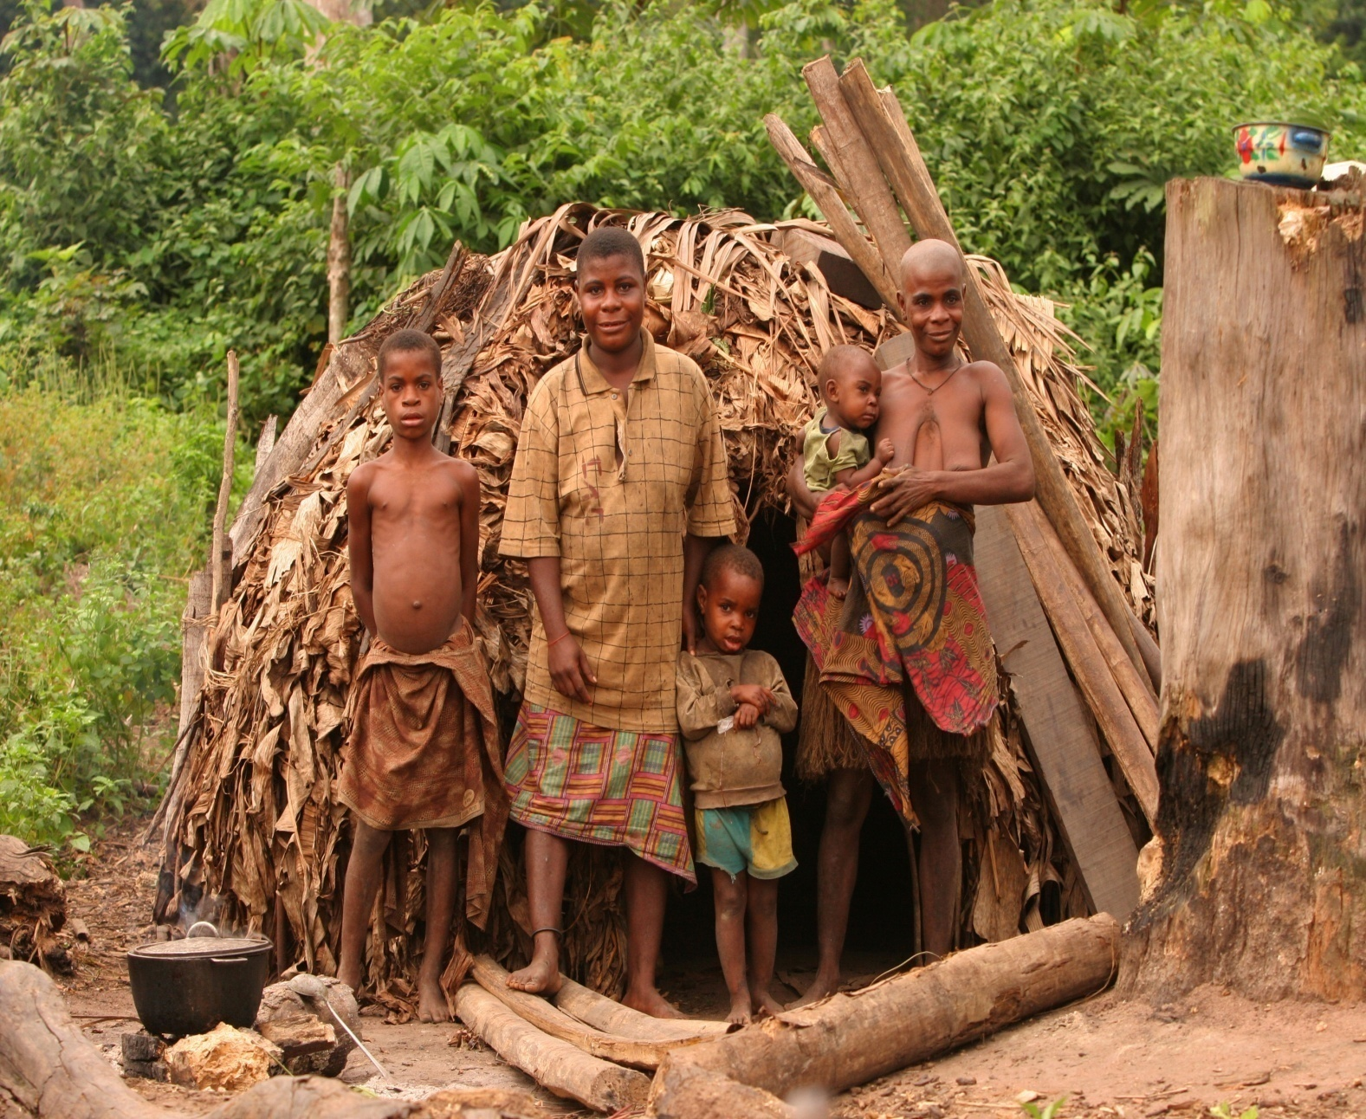
PROTECTION DES DROITS DES PEUPLES AUTOCHTONES : STRATEGIES ET PROGRES

Slide 12
National progress of preservation of indigenous rights
- Qualification of indigenous organisations (creation of a network of the indigenous people of Congo “RENAPAC”)
- Declaration of a law to promote and protect the rights of the indigenous people; Necessity of promotion and usage
- Changes of social norms; articles are publish, Action Plan 2010-2013
- Attendance of indigenous people during the implication of the REDD-Plus mechanism
- Organisation of the International Forum of the indigenous People of Central Africa
Notes:
La REDD (Réduction des Émissions liées au Déboisement et à la Dégradation de la forêt) est une
proposition d’un mécanisme où les pays développés accordent des compensations aux pays en développement
qui réduisent les émissions de gaz à effet de serre résultant du déboisement et/ou de la dégradation de
leurs forêts.

Slide 13
Contribution scientifique des peuples autochtones au système GEOSS.
Traditional knowledge offers chances to research and promotes it (examples are given after the sociologist Marie Boundawana Yaifono)
Improvements in the fields of environmental reperocussions and natural resources management and also in medical research and ecological genetics
The « alimédicaments » sustains advanced research in chemical research, in biology, in nutrition, in physiology, in medicine etc.).
Modern medicine uses lot of the traditional pharmacy
Research in Bioacutics and retrovirology are attracted by the traditional knowledge

Slide 14
Contribution scientifique des peuples autochtones au système GEOSS (suite).
Research in the fields of land rights
indigenous knowledge for forest preservation
Improvements in the fields of obstetrics
Cultural sites protected by the indigenous people offer the possibility for research (archaeology, palaeontology, ethnology, anthropology etc.)

Slide 15
Contribution scientifique des peuples autochtones au système GEOSS (fin).
Les sites archéologiques et cultuels protégés par les autochtones offrent une opportunité pour les recherches dans le domaine de l’archéologie, de la paléontologie, de l’ethnologie, de l’anthropologie, etc.
Les connaissances traditionnelles sur le cycle des climats et le calendrier saisonnier inspirent la construction des théories des sciences de la terre (Géologie, géographie, l’astrophysique, la physique, la chimie minérale et organique, la thermodynamique, la paléoclimatologie, l’archéologie), etc.

Slide 16
Leçons apprises
Lessons learnt
- Often the knowledge of the indigenous people is misjudged and not taken into account
- They are taken out of the livelihood and put into protected areas, which change their way of living
- indigenous people are put in exclusion
- Initiatives have to value the culture and inestimable knowledge concerning the forest of the indigenous people

Slide 17
En guise de recommandations
Recommendations
Individuals and multinational companies have to respect the secret and esoteric knowledge of the indigenous people and are not allow to make this knowledge accessible to the public without their agreement.
It is obligatory to promote university research in the fields of traditional knowledge to benefit in social science and to promote inventions in the fields of medicine and biotechnology.

Slide 18
Methode et pilotage
Exploitation des initiatives
Initiative A
Initiative B
Initiative C …
Notes:
Les initiatives de ces peuples autochtones sont en fait leurs connaissances non utilisees a ce jour par touts les systemes.
Pour pouvoir utiliser ces initiatives il faut construire au plan local la meme structure de projet que celui d´EGIDA.
Ainsi nous reussirons a valoriser les contributions des peuples indigenes dans la construction du systeme des systemes.

Slide 19
How to do?
Actions with EGIDA
Method EGIDA
Exploitation
Actions propres au Congo
Preservation of the environment and the biodiversity
Protection of the indigenous people
Notes:
Pour reussir cela, notre objectif est de mettre en place l´ensemble des politiques qui vont permettre de :
Proteger les populations autochtones, par ensemble de lois pour garantir la propriete fonciere, pour renforcer leur libre circulation …
Creer un environnement scientifique et universitaire par l´echange pour mieux collecter, mieux analyser et mieux restituer les connaissances des peuples autochtones selon la methodologie EGIDA,

Slide 20
Some benefits for the indigenous people
The pilot projects :
Access to drinking water
health.
Biodiversity .
Alternative energy.
Agriculture.
Notes:
La vie de ces populations est tellement difficile qu´un simple projet pilote chez eux pour ameliorer considerablement leurs conditions.
Parmi tous les neuf are d´EGIDA les populations autochtones sont particulierement conser

Slide 21
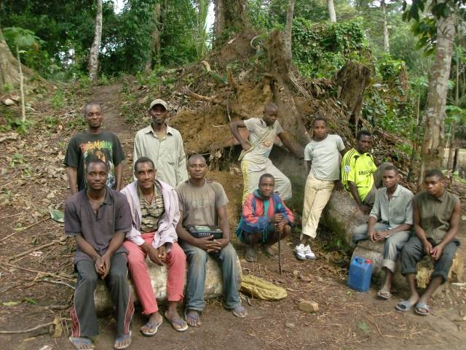
Ensemble faisons avancer l’humanité

Slide 22
MERCI DE VOTRE ATTENTION

