Slide 1
The Communities of Practice: Implementation & Users
Engaging Users?
Meeting User Expectations?
Gary J. Foley, PhD
Co-chair, User interface Committee
10 April 2011

Slide 2
2005: Canadian Co-Chair introduces CoP concept to GEO Plenary and UIC
Communities of Practice are . . .
Groups of people who share a concern, a set of problems, or a passion about a topic and deepen their knowledge by interacting on an ongoing basis
Etienne Wenger
Richard McDermott
Bill Snyder
Cultivating Communities of Practice, Harvard Business School Press, 2002

Slide 3
CoP Classic Characteristics
Self-organizing
Informal
Boundary-spanning, outside organizations
Many kinds of members: contributors, lurkers, newbies, facilitators, etc.
Members distributed throughout an organization
Voluntary, based on trust
Sharing of best practices in reusable knowledge base
Require more than just discussions

Slide 4
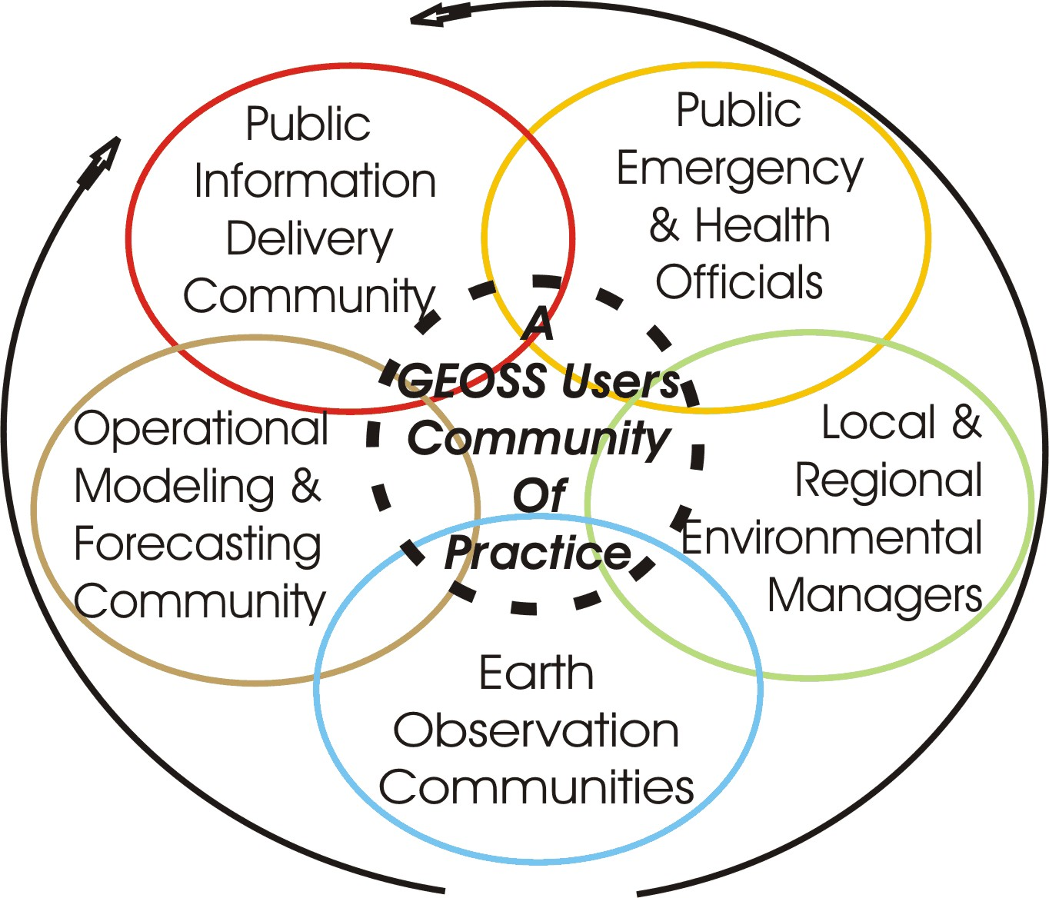
The Public
Public Officials
NGOs

Slide 5
2009: Lessons Learned and Advice for new CoPs
CoP can bridge the gap between data and end-users/decision makers
CoP can serve multiple goals for multiple audiences
Air Quality example: provide outcomes and tools specific to the community (Air Quality Portal); also contributes to larger GEOSS community by interfacing with GEOSS common infrastructure
CoP’s should be functional units
Separate outcomes may need separate communities
Overlap / Collaboration for specific outcomes

Slide 6
How the CoP concept and the ‘network of networks’ model is implemented by GEO BON
The Vision of GEO BON is for a coordinated, global network that gathers and shares information on biodiversity, provides tools for data integration and analysis, and contributes to improving environmental management and human well-being.
main implementation platform - Biodiversity SBA

Slide 7
A “network of networks”
To strengthen and coordinate the activities of a diverse set of partners towards a common goal
improved biodiversity information for a wide range of users
Steering Committee and 8 Working Groups
pragmatically constituted, reflecting the way the biodiversity community is organised and interacts
Regional BONs serving biodiversity observation needs of a group of neighbouring countries; forming spontaneously or with GEO BON facilitation
Topical BONS focused on a particular set of biodiversity issues

Slide 8
Current success with the CoP approach:
GEO BON
a wonderful response and great success
Regional BONs joined/wanting to join
Working Groups building partnerships, CoPs
Specific requests from the user community
Request for workshop to prepare report
CoP Concept:
Working well; Bringing in individuals, groups, organisations and regional initiatives

Slide 9
Objectives for the Forest CoP
communication and coordination of the forest GEO work plan task teams
agreement on user community requirements for forest observations: present status and gaps
Advise the UIC, other CoPs and GEO on matters relating to forest observations, related SBAs, and on cross-cutting issues
Support the forest observation community with information on activities and plans in the GEO process

Slide 10
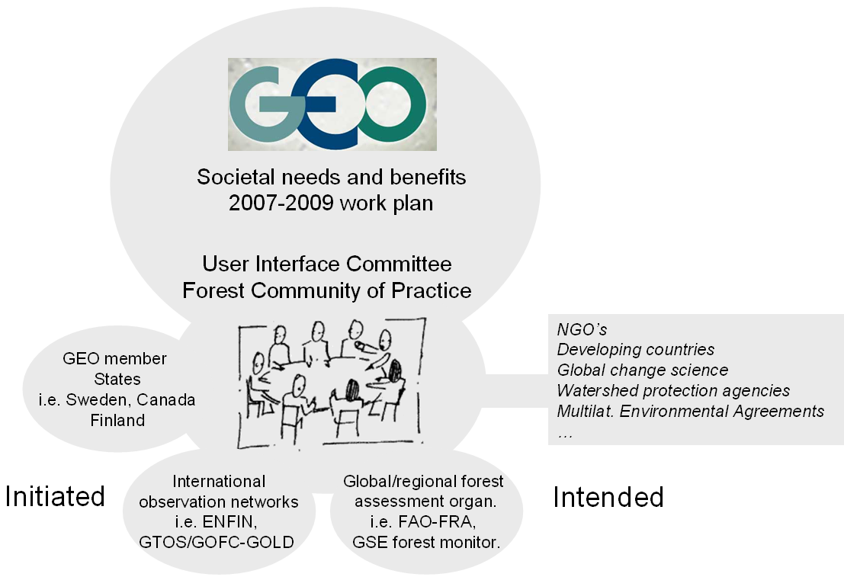

Slide 11
Success in linking the GEO tasks to users of forest observations
Members have expressed interest in:
Proceeding with the design of a global forest observations initiative (GFOI), an ambitious activity to which all eight GEO forest Tasks would contribute.
Fostering better connection between remote sensing and ground-based observations.
Collaborating with the Global Agriculture Monitoring CoP to fully address the Agriculture Societal Benefit Area.
Evaluate progress using several indicators

Slide 12
IGWCO COP and User Engagement
IWGCO CoP evolved from an IGOS-P Theme Team
Engaged users during the past two years:
Seeking to increase user involvement through participation in meetings and workshops,
Launching joint projects with users,
Launching specific user engagement activities by specific tasks.

Slide 13
User Engagements Successes
Three workshops in the last three years; all attracted new users, some high level users and new countries
IEEE Demonstration Projects on Water Discovery; launched with users; providing reliable water resources for a villiage
Several drought-focused efforts involving many user-driven workshops in Canada
Water Cycle Initiatives in Asia, Africa and Latin and Caribbean America ; leading to training and demonstration projects for users

Slide 14
Energy CoP Objectives
Support GEOSS outcomes
• Siting of facilities including environmental & sociological issues
• Optimized design of power systems and facilities
• Yield estimation and resource monitoring based on historic info
• Yield forecast based on near real time weather and forecasting
• Integration into existing energy supply, e.g. grid & utility systems
• Operation & management of power plants; automatic failure detection
• Trading and monitoring of power and environmental credits
• Environmental monitoring of impacts
• Life cycle considerations and Economic analyses

Slide 15
Successes for Users
Three GMES Projects delivered to users documents on the exploitation of earth observations for renewable energy – wind and solar – development: MESOR, EnerGEO and Endorse
Establishment of an Energy Community Portal
Participation in AIP-2 and 3 on interoperability; view the reports and video
A Community Catalogue has been registered in the GEOSS Component and Service Registry and is now harvested weekly by GEOSS crawler’s

Slide 16
GHCP and the Broader GH Community
ensure that the needs of this community are taken into account in the development of GEOSS,
facilitate support and participation of this community in the building of GEOSS, and
promote the use of GEOSS for geohazards-related applications.
provide a communication and coordinating platform for high level policy makers and the broader geohazards community

Slide 17
The Supersites Initiative
Supersites are now being established for every major earthquake, and these sites enjoy increasing popularity.
The above defines a rather broad group of users to be engaged in the GHCP including all stakeholders in the four phases of risk management.

Slide 18
Tandem Centers
The concept of tandem centers of excellence envisioned for the implementation of the GHCP Road Map likely will help to link to end users.
These tandem centers will each pair a center of excellence in a developed country with a similar center in a developing country, where they will serve as a regional nucleus for risk management.

Slide 19
Coastal Zone CoP: Engaging End Users
CZCP evolved from an IGOS-P Theme Team
bring together scientific & non-scientific experts
focuses on research and practical applications
Organizes regional workshops addressing the decision support through Earth observations for integrated coastal zone management
Includes as users: coastal zone researchers, operators of infrastructure, planners, policy makers and inhabitants

Slide 20
Regional Workshops
Athens 2008: emphasized the gap between providers and decision makers, however, decision makers were underrepresented.
Caribbean 2011: recommendations address the need for improved communication between providers and users, e.g. between stakeholders of sustainable tourism and providers of EO & related services.
A major conclusion that outreach to and engagement of end users would work better if the CZCP would participate in the meetings (workshop, conferences) organized by end user groups, instead of organizing independent workshops and attempting to bring the end users to these workshops.

Slide 21
There is More Comprehensive Information in the Handouts from the CoPs
Please look at Them

Slide 30
GEO Website: CoP’s
Coastal Zone: “The Coastal Zone Community of Practice (CZCP) supports the Group on Earth Observations (GEO) in its goal to provide observations required for informed decisions concerning the coastal zone. High and immediate priorities for GEOSS are improved forecasts of sea-level rise and associated increases in coastal inundation that may be exacerbated by increases in the frequency of extreme weather.”

Slide 31
GEO Website: CoP’s
Water Cycle: “The aim . . . is to provide a unique perspective on the information needs of the water community by bringing together representatives who have knowledge of the decision processes in the water sector with those who have an interest in seeing Earth Observations being used more effectively to address those questions.”

Slide 32
GEO Website: CoP’s
Energy: The objective of the Energy Community of practice (ECP) is to support GEOSS outcomes related to the application of Earth Observation data for energies. Relevant areas are:
Siting of power plants and facilities including environmental and sociological issues
Optimized design of power systems and facilities
Yield estimation and resource monitoring based on historic information
Yield forecast based on near real time weather and forecasting
Integration into existing energy supply, e.g. grid & utility system integration
. . . . Etc.

