Slide 1
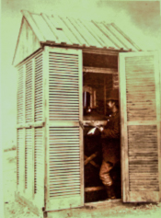
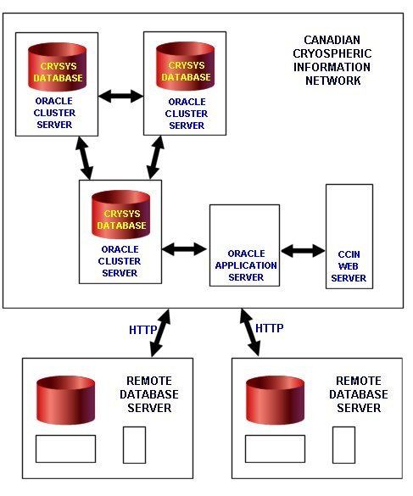
POLAR DATA: MOVING ON FROM IPY
IPY 1 1882
CCIN 2002
PDC/DACN

Slide 2
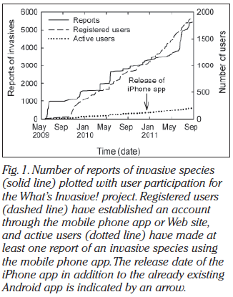
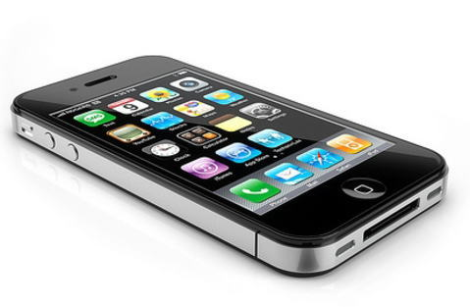
Using Mobile Phones
to Engage
Citizen Scientists
in Research
Eric A. Graham, Sandra Henderson, and Annette Schloss, Eos, Vol. 92, No. 38,
20 September 2011

Slide 3
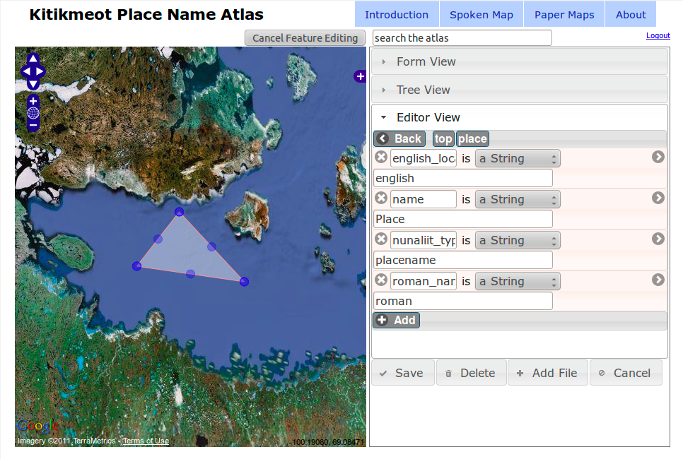

Slide 4
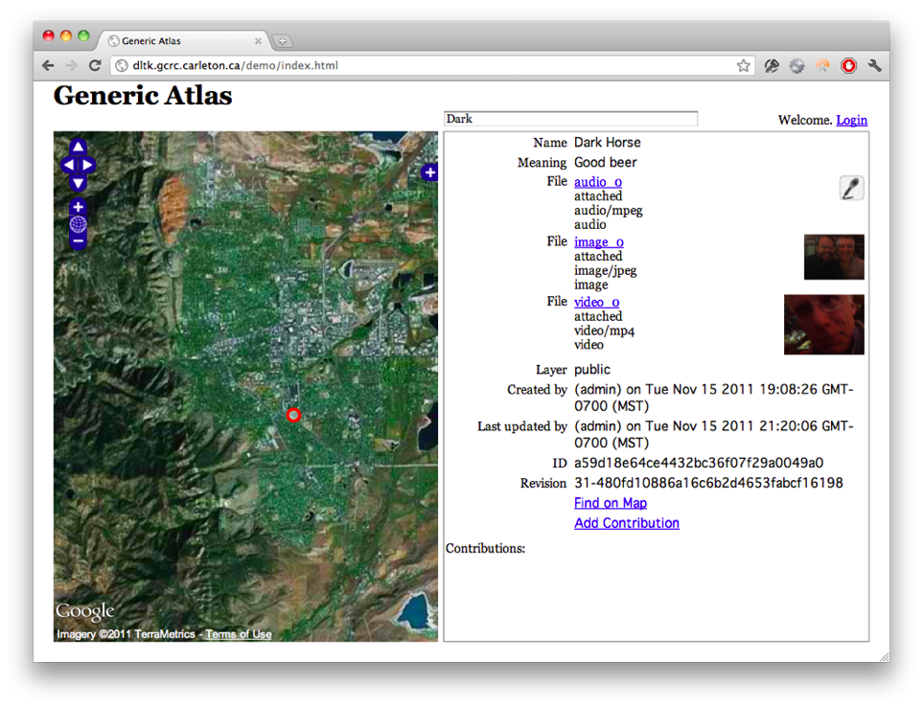

Slide 5
THE FUTURE OF POLAR INFORMATION MANAGEMENT - CHARS
Global and local Information in your pocket
Streaming data
from remote
instrumentation
Data translated
into useful information
Arctic Informatics Hub
Partnerships with
many data
networks
Preservation in long-term access
Enlightened Citizens as Scientific Collaborators
Belmont Forum ?

Slide 7
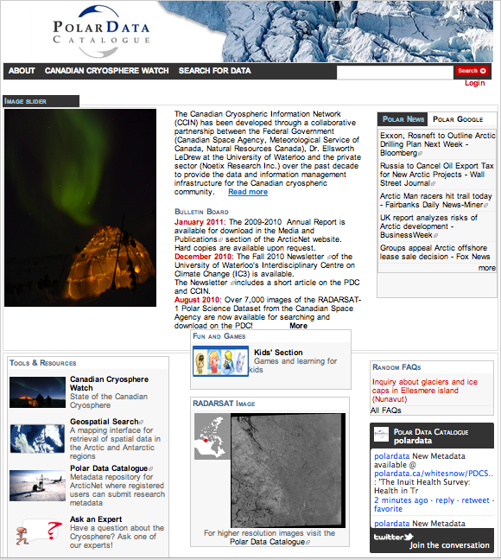

Slide 8
FROM DATA TO INFORMATION TO ACTION
User involved from the beginning
‘Success for GEOSS could be achievement of a set of targets for which the users feel ownership’
Decision makers need data (information) pull capability
Co-design, Co-development, Co-production:
If useful for fisheries, fisheries must be at the table from the beginning

Slide 9
Building a User-Driven GEOSS
Re-energize the Communities of Practice
Part of governance process within GEO
The Social and Methodological ‘Glue’
Prevent the tasks from being silos
Spectrum of Users – novice to expert
Adapt process to needs of community
Data and information provided by users and accessible by the users

Slide 10
Sustainable development is a result of decisions by USERS in the planning process

