Slide 1
The role of Earth Observation in agriculture to support Food Security and the MDG
Steffen Fritz
Ecosystem Services and Management Program, IIASA
Acknowledgements
Inbal-Becker Reshef, Joao Soares, Hugo Valin,Christoph Perger , Christian Schill, Linda See, Ian Mcallum, Dimitris Schepadschenko, Aline Mosier, Petr Havlik, Marijn van der Velde, Sabine Fuss, Florian Kraxner, Michael Obersteiner

Slide 2
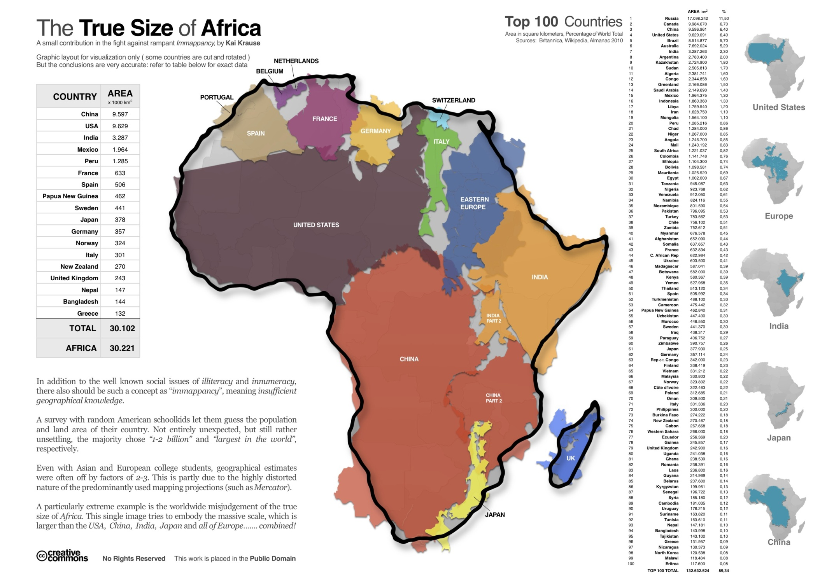

Slide 3
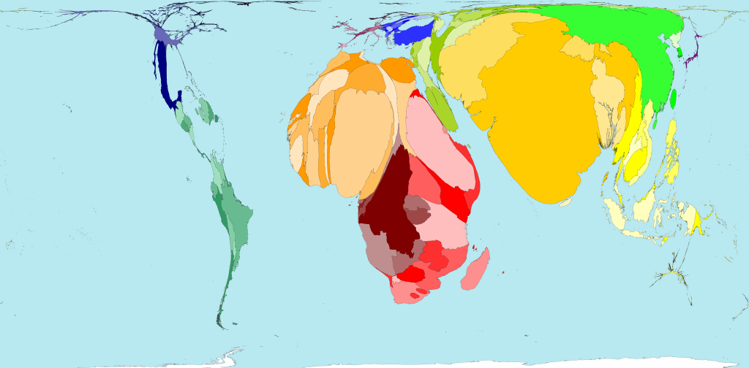
Infant Mortality

Slide 4
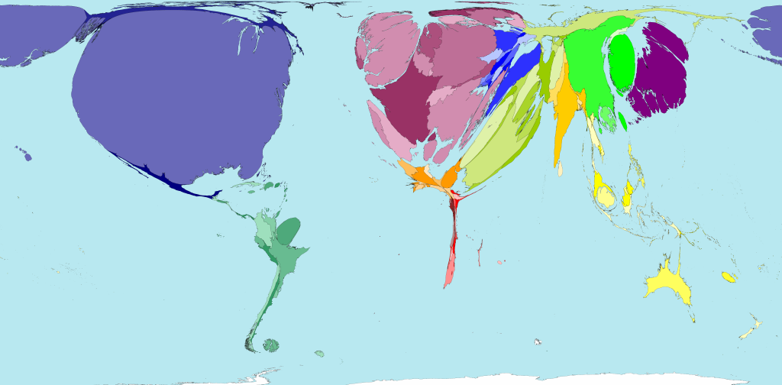
Military spending

Slide 5
Outline
Food security – Global situation
Biofuel debate
Data quality issues around marginal land, mapping land cover and crop acreage, Geo-wiki, Crowdsourcing efforts at IIASA
New technologies to improve in-situ data
The GEOGLAM intiative

Slide 6
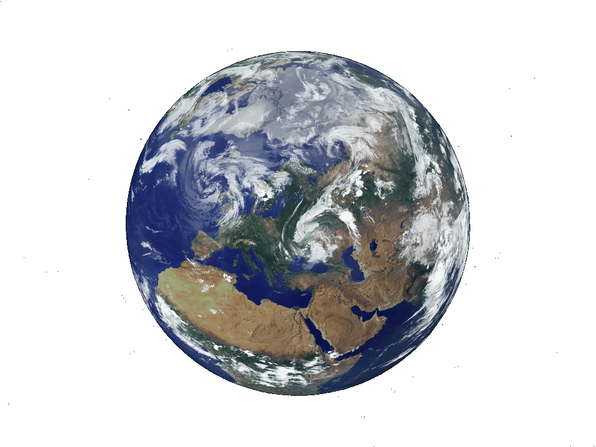
The world in 2030:
7.5-8 billion people
temperature increase > 1 degree
Energy consumption is projected to be 50% higher
Water demand is projected to be 50% higher
Little wilderness, new diseases....
Competition for land will increase ....
Food demand is projected to increase by >40%
… governments will be asking for information
… a lot of information is out there, accessibilty is crucial, data quality is essential, gaps exist
…new data from observing systems will become available

Slide 7
World Cereal Production since 1960 in Hecta Grams

Slide 8
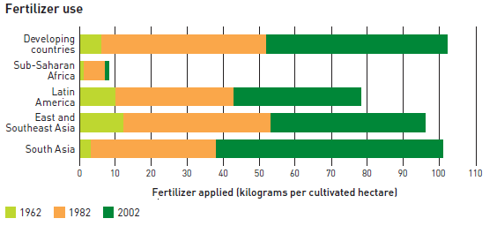
Fertilizer use in developing countries
Source: FAO, State of Food Insecurity in the world, 2008

Slide 9

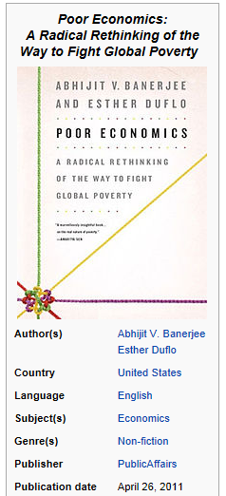
Why has Africa missed the green revolution?

Slide 10
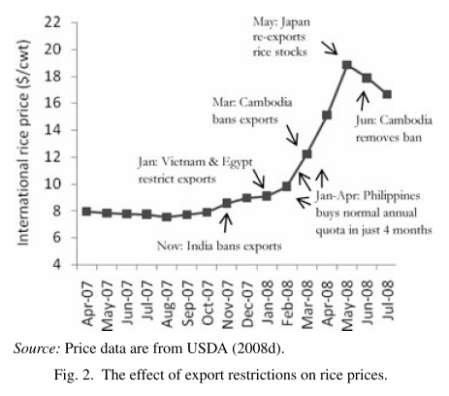
Rice Market in the 2007-2008 Crisis
Source: Headey and Fan (2008)

Slide 11
The Biofuel Debate

Slide 12
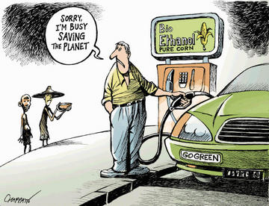
Food vs. fuel concerns since the 2008 crisis
Notes:
http://www.livetradingnews.com/the-rise-of-biofuels-64907.htm
http://elfael.wordpress.com/2008/04/02/peak-food-and-japan-part-1-price-rises-and-causes/
http://priceofoil.org/2009/08/17/policy-re-think-needed-for-biofuels-bogeyman/
http://gulfofmexicooilspillblog.com/2011/02/14/gulf-of-mexico-oil-spill-blog-biofuels-world-food-crisis/
http://permaculture.org.au/2010/06/02/cars-and-people-compete-for-grain/
http://burningissues.org/forum/phpBB2/viewtopic.php?f=13&t=795&start=0

Slide 13
The controversy around food crisis
Source | Date | Statement
IMF World Economic Outlook | 17 October 2007 | Warns against effect of biofuel
UN Rapporteur on the Right to Food | 26 October 2007 | "Crime against humanity"
FAO Environment Assessment and Management Unit | 1 November 2007 | Ziegler’s remark regrettable
JRC Report leakage | 18 January 2008 | Contribution of +4% for cereals and +24% for vegetable oil
Nestle CEO | 24 March 2008 | "Threat for food security"
European Environment Agency | 10 April 2008 | Ask for suspension of EU biofuel mandate
UN Secretary | 14 April 2008 | Call for a review of biofuel policies
IMF Chief Economist | 14 April 2008 | Contribution of 20 to 30 %
UN Rapporteur on the Right to Food | 14 April 2008 | "Crime against humanity" (2nd time)
US White House | 29 April 2008 | Contribution of 15%
White House Council of Economic Advisor | 1st May 2008 | Contribution of 2-3%
USDA Chief Economist | 21 May 2008 | Contribution of 10%
US Secretary of agriculture | 4 June 2008 | Contribution of 2-3%
Oxfam: "Another Inconvenient Truth" Report | 25 June 2008 | Contribution of 30%
World Bank "secret report" | 3 July 2008 | Contribution of 75%
OECD Report | 16 July 2008 | Contribution of: 5% for wheat 7% for corn, 19% for vegoil
FAO Director | 8 October 2008 | "Opportunities and risks"
Collected by Hugo Valin, IIASA

Slide 14
The controversy around food crisis
Source | Date | Statement
IMF World Economic Outlook | 17 October 2007 | Warns against effect of biofuel
UN Rapporteur on the Right to Food | 26 October 2007 | "Crime against humanity"
FAO Environment Assessment and Management Unit | 1 November 2007 | Ziegler’s remark regrettable
JRC Report leakage | 18 January 2008 | Contribution of +4% for cereals and +24% for vegetable oil
Nestle CEO | 24 March 2008 | "Threat for food security"
European Environment Agency | 10 April 2008 | Ask for suspension of EU biofuel mandate
UN Secretary | 14 April 2008 | Call for a review of biofuel policies
IMF Chief Economist | 14 April 2008 | Contribution of 20 to 30 %
UN Rapporteur on the Right to Food | 14 April 2008 | "Crime against humanity" (2nd time)
US White House | 29 April 2008 | Contribution of 15%
White House Council of Economic Advisor | 1st May 2008 | Contribution of 2-3%
USDA Chief Economist | 21 May 2008 | Contribution of 10%
US Secretary of agriculture | 4 June 2008 | Contribution of 2-3%
Oxfam: "Another Inconvenient Truth" Report | 25 June 2008 | Contribution of 30%
World Bank "secret report" | 3 July 2008 | Contribution of 75%
OECD Report | 16 July 2008 | Contribution of: 5% for wheat 7% for corn, 19% for vegoil
FAO Director | 8 October 2008 | "Opportunities and risks"

Slide 15
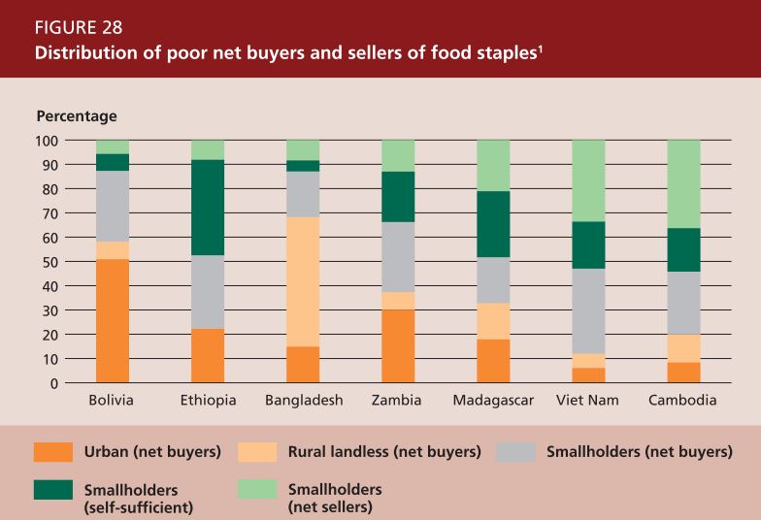
Food price increases: Situations are different in each country
Source: State of Food, FAO, 2008

Slide 16
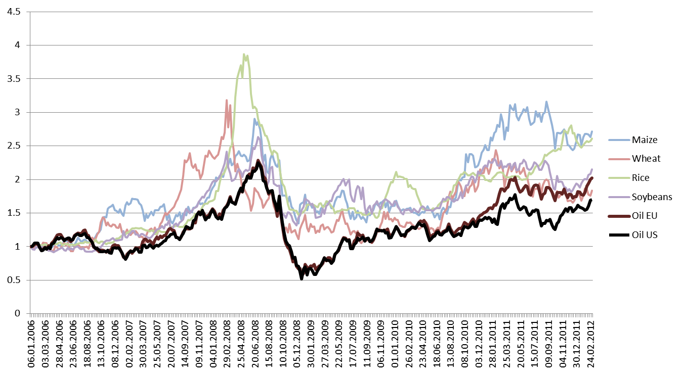
Index 2006 = 1 (not deflated)
Source: FAO, price database 2012; US EIA, 2012

Slide 17
The discussion around available and marginal land – land grabbing

Slide 18
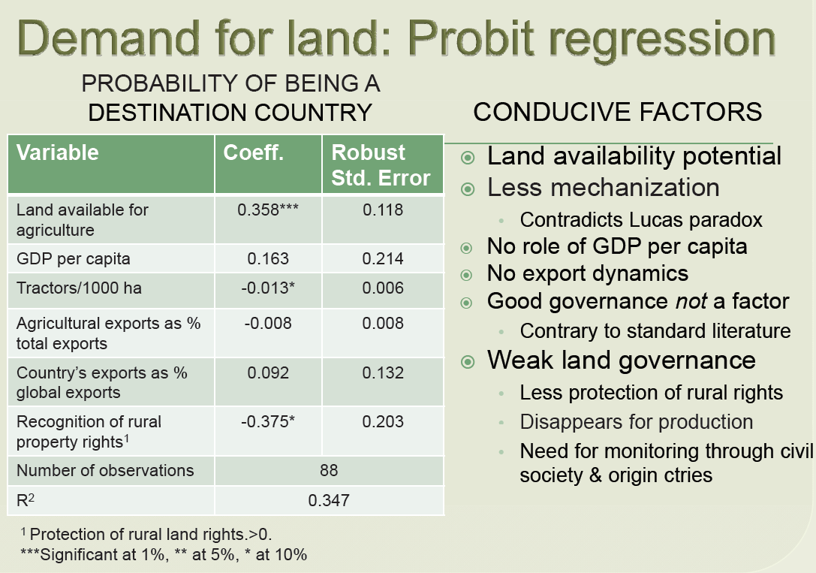
Competition for land – land availability
Report by the world bank
Source World Bank: Deininger et al., 2011, Rising global interest in farmland

Slide 19
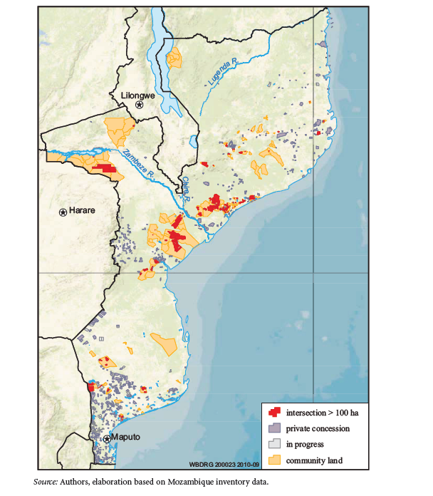
Source World Bank Report
Source World Bank: Deininger et al., 2011, Rising global interest in farmland

Slide 20
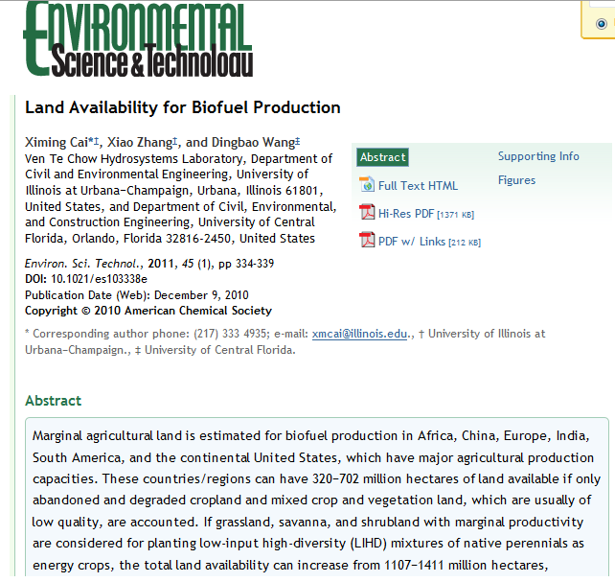

Slide 21
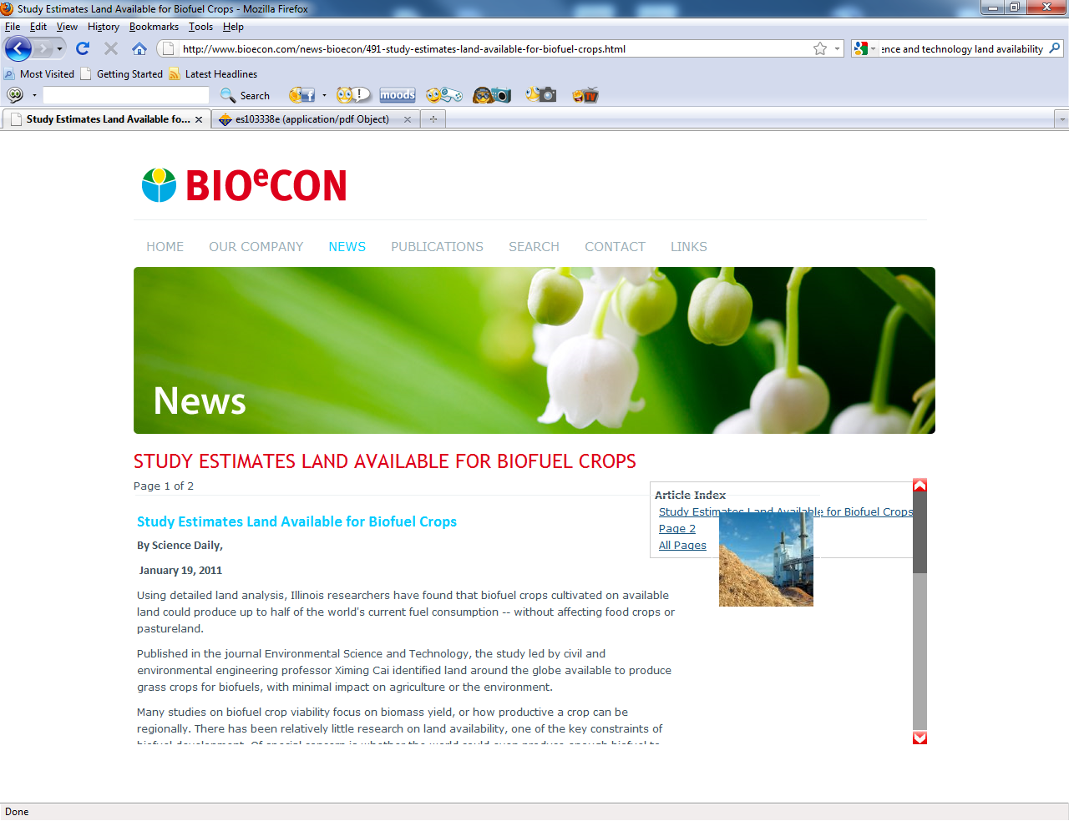

Slide 22
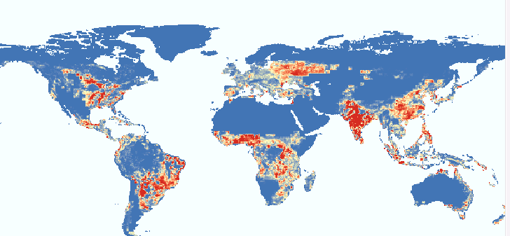

Slide 23
Data quality issues around marginal land, land cover and crop acreage, Geo-wiki, Crowdsourcing efforts at IIASA

Slide 24
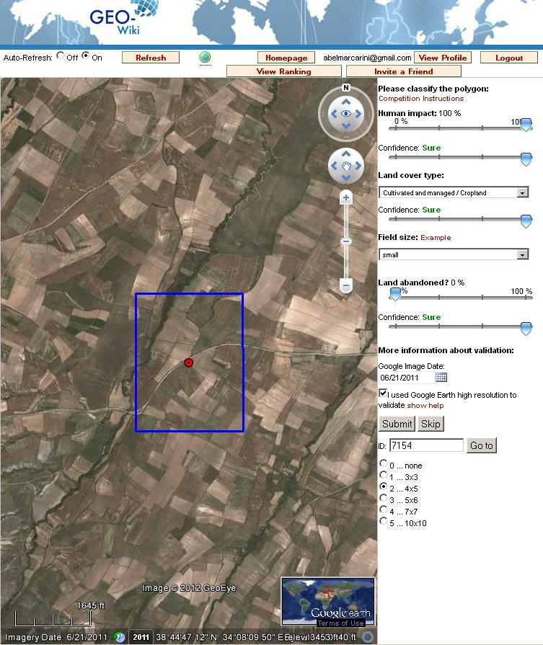
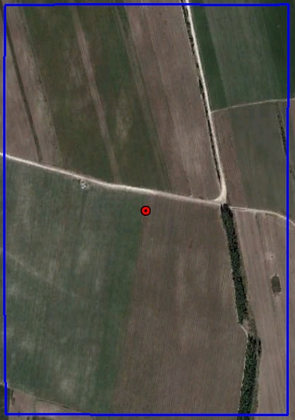
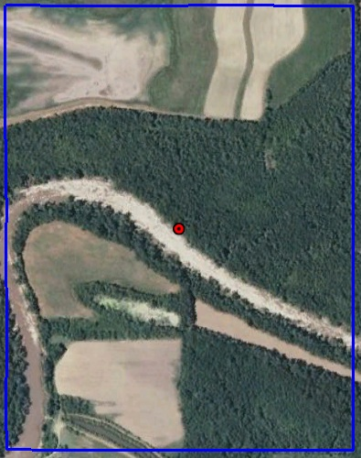

Slide 25
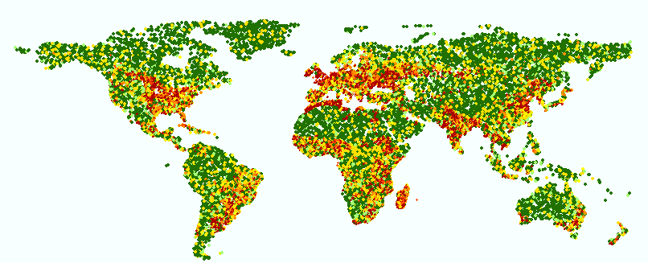
Map improvement via crowd-sourcing
About 450 users in more than 120 countries
> 55,000 validation points

Slide 27
Much less marginal land is available

Slide 28
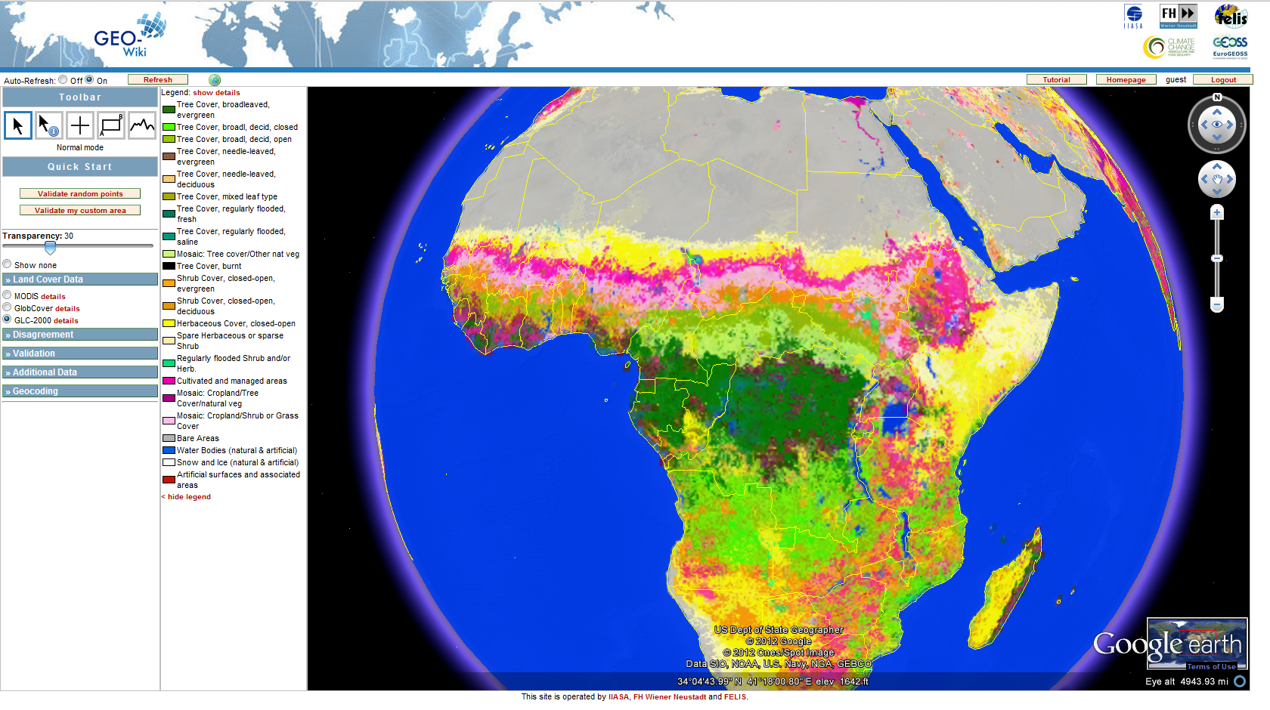

Slide 29
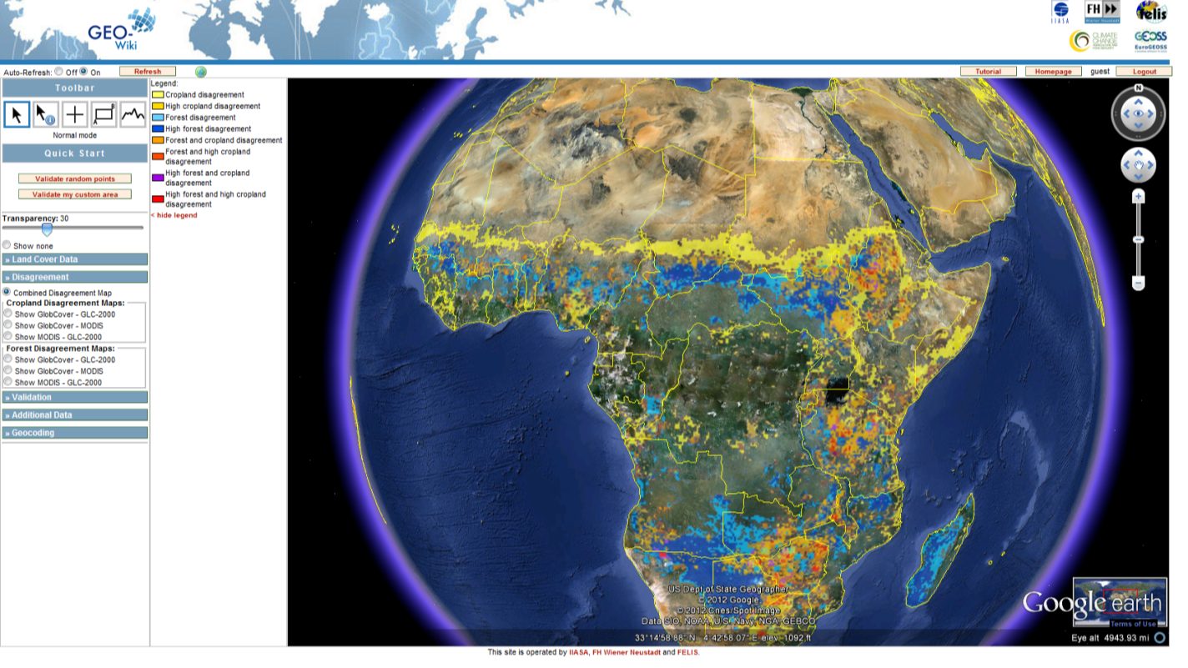
Geo-Wiki Project: Disagreement

Slide 30
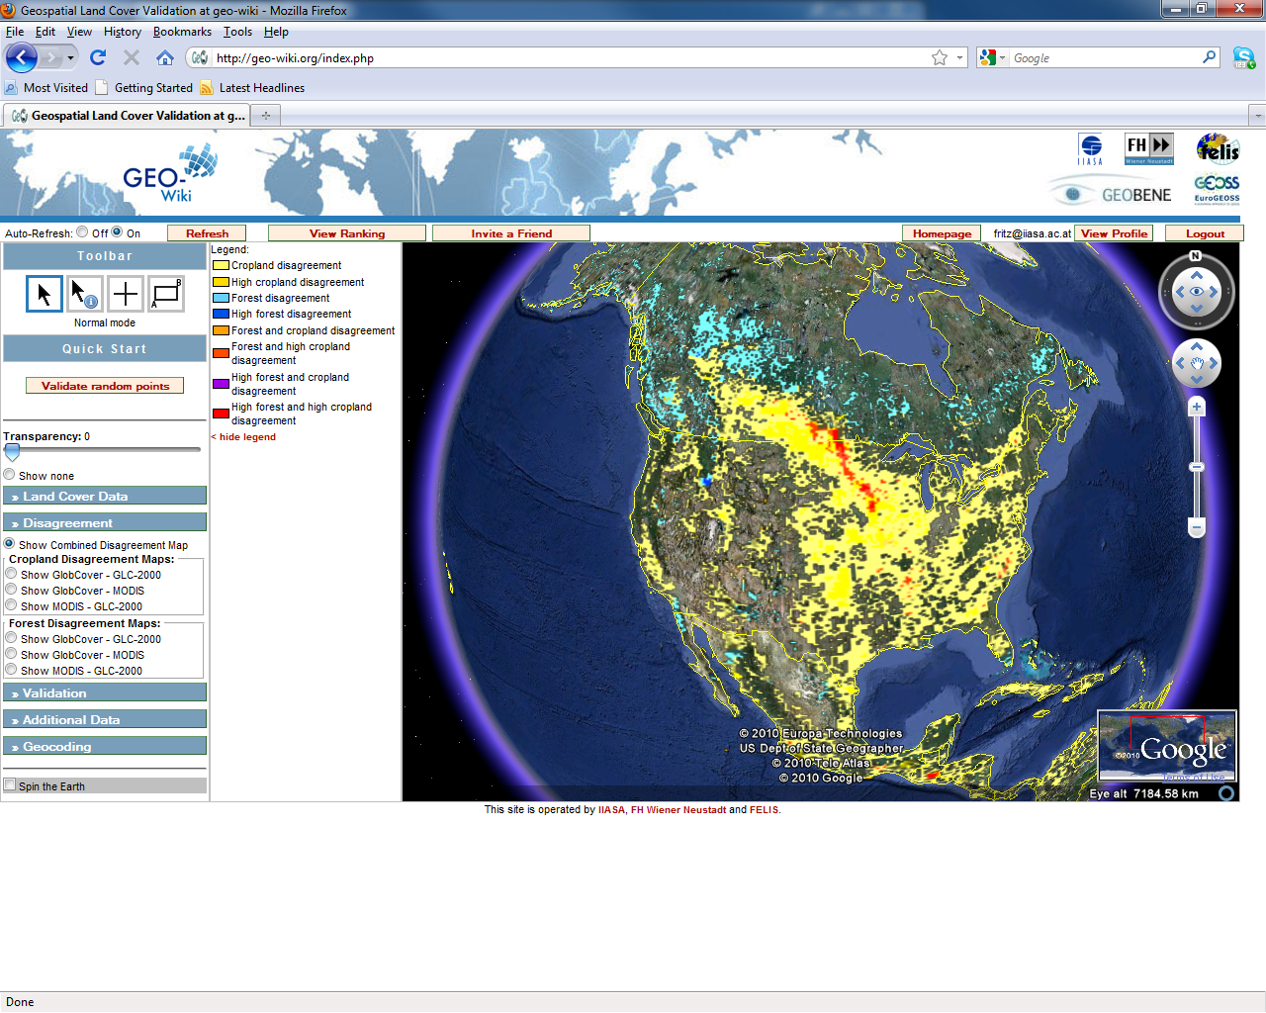

Slide 31
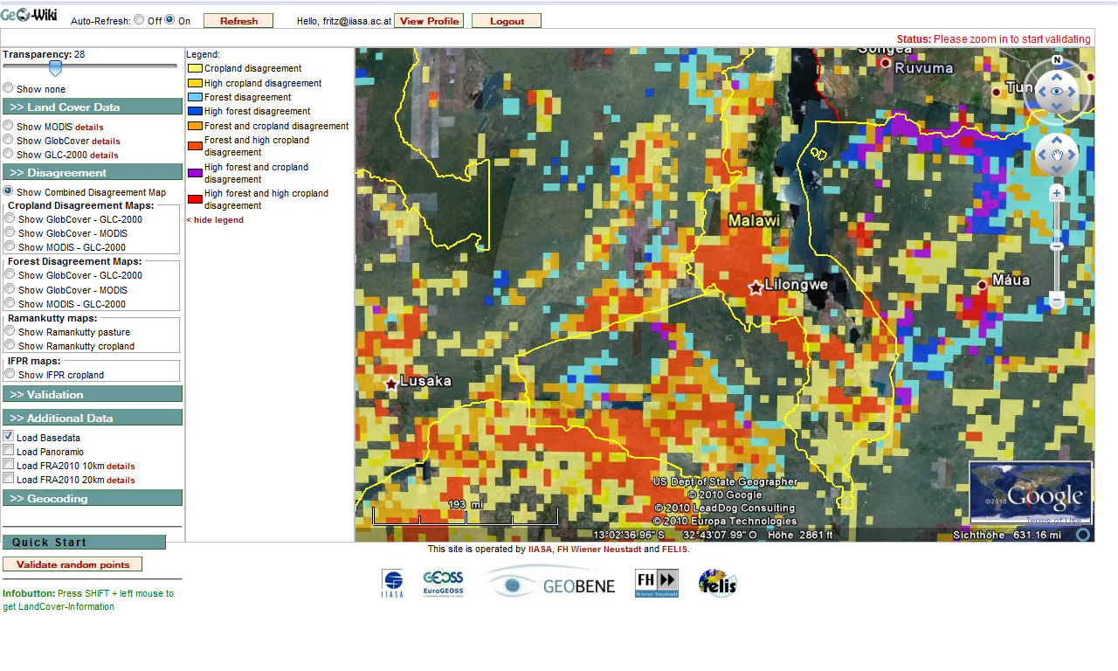

Slide 32
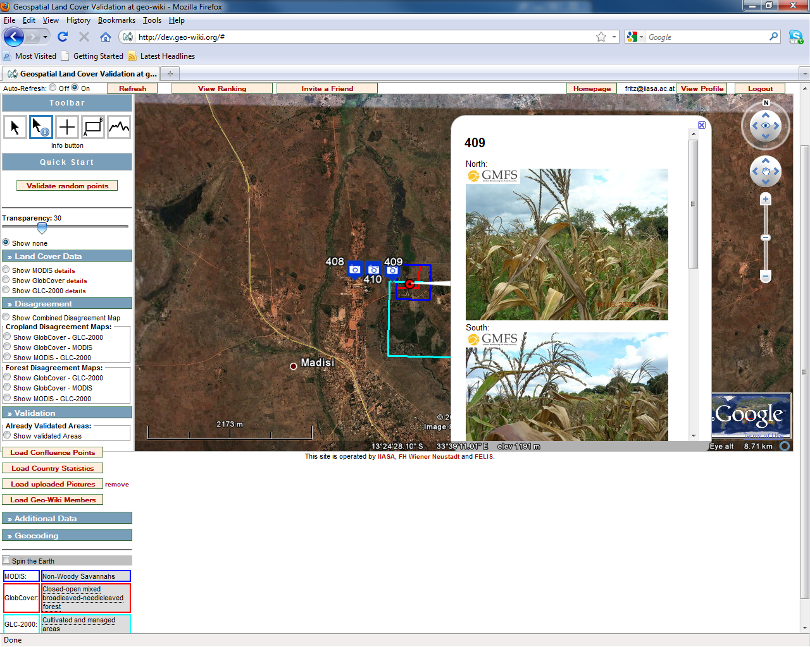

Slide 33
New technologies to improve in-situ data

Slide 34

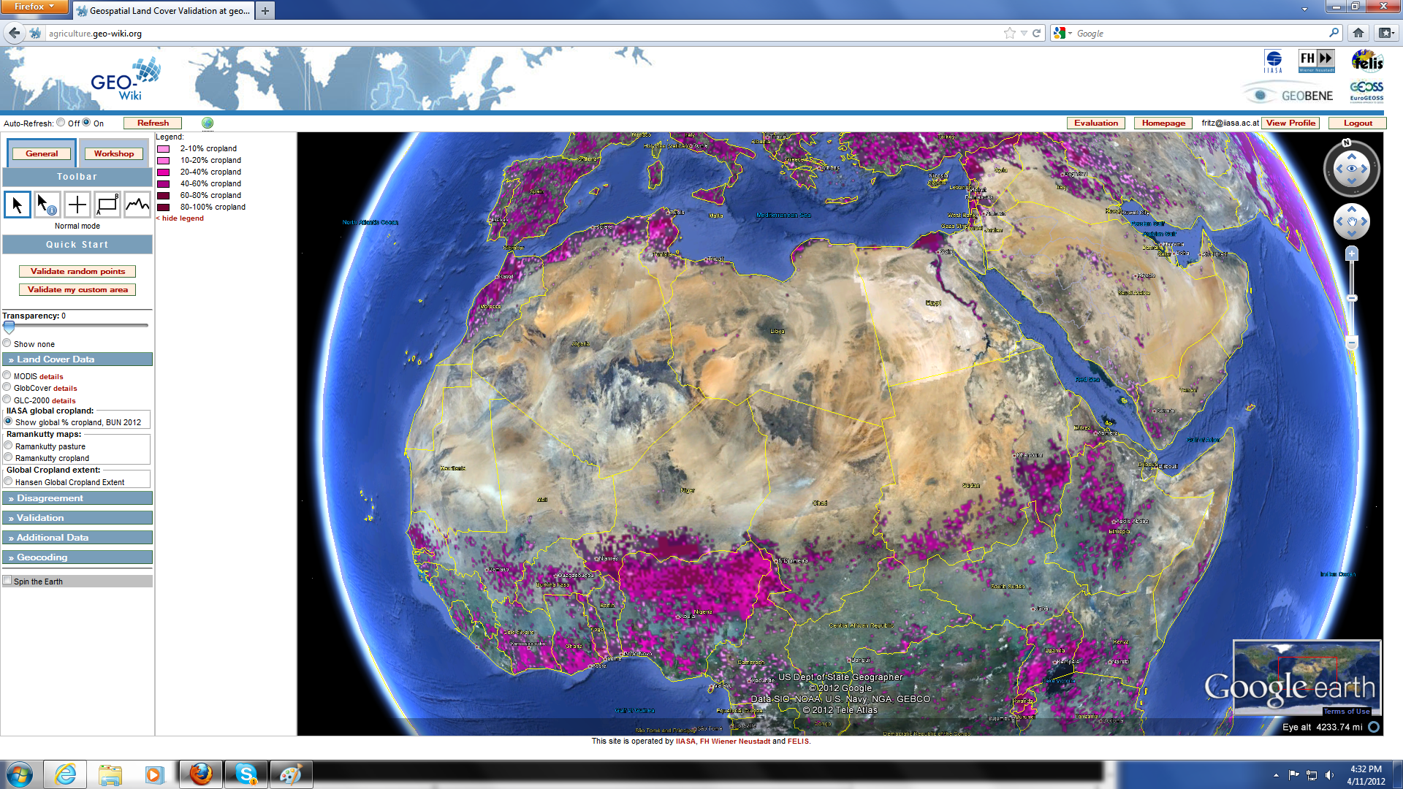

Slide 35

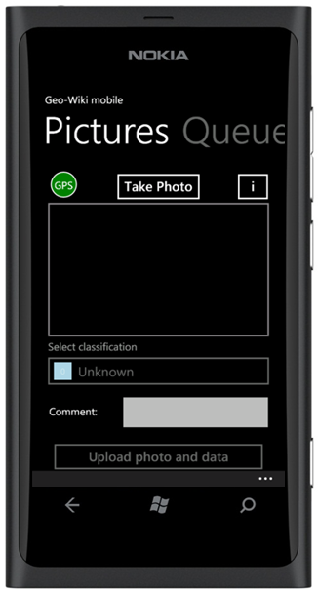

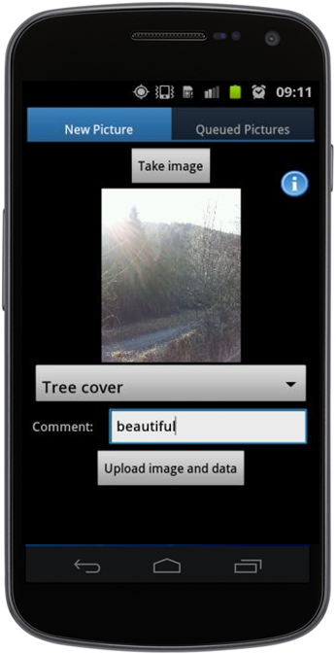
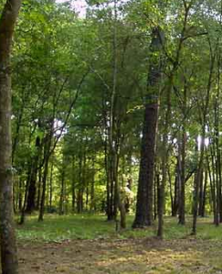
Geo-Wiki mobile – new technologies...

Slide 36

FarmSupport – APP: Menue

Slide 37
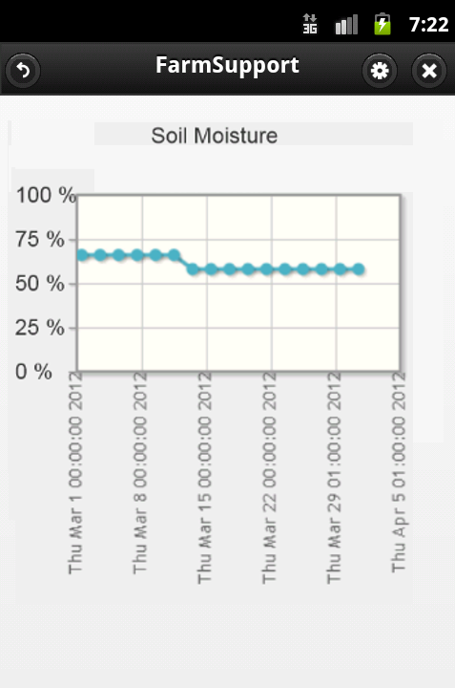
FarmSupport – APP: Soil Mosture

Slide 38
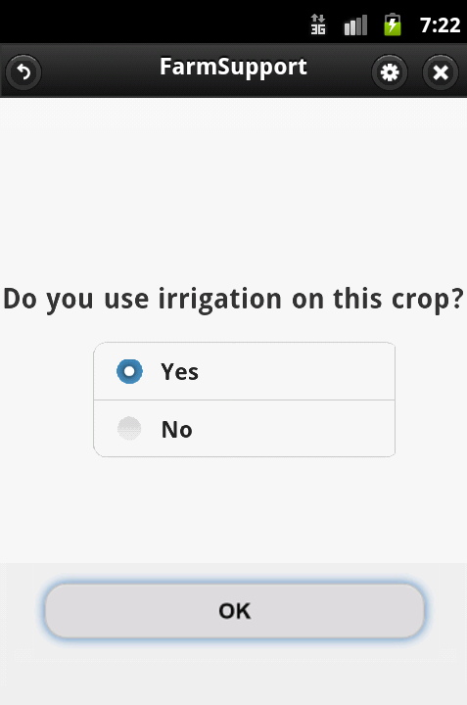
FarmSupport – APP: Sample Question

Slide 39
Data Sharing and GEOGLAM

Slide 40
GEO-GLAM
The GEO led Initiative for
GLOBAL AGRICULTURAL MONITORING
GEO Agriculture Community of Practice
40

Slide 41
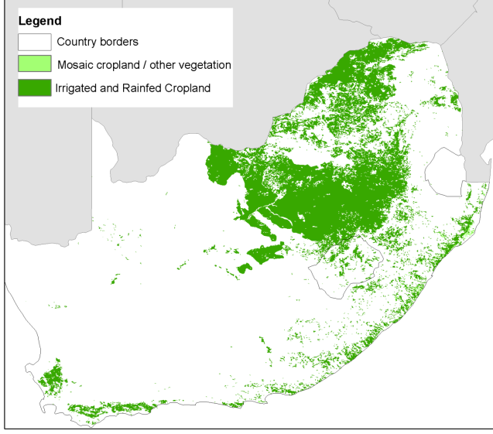
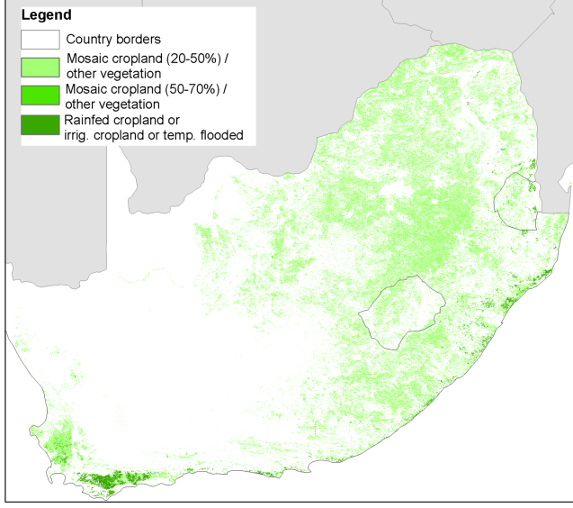
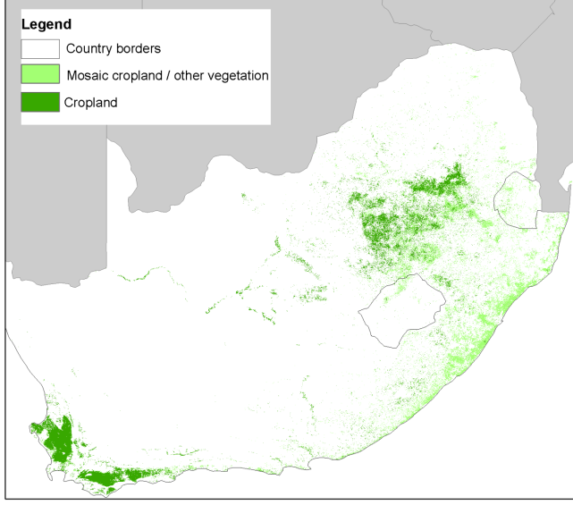
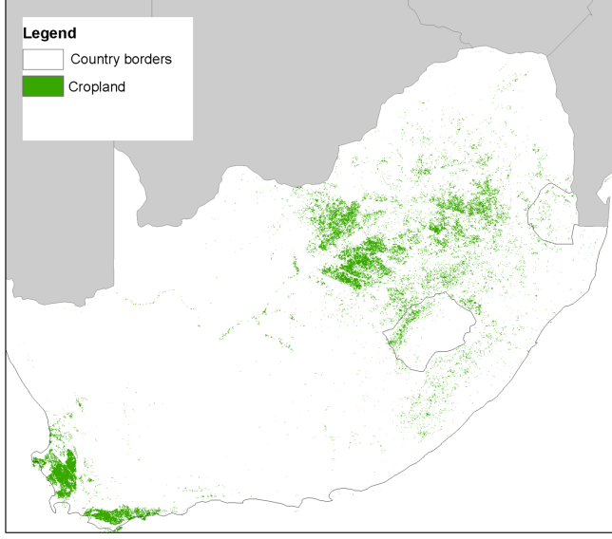
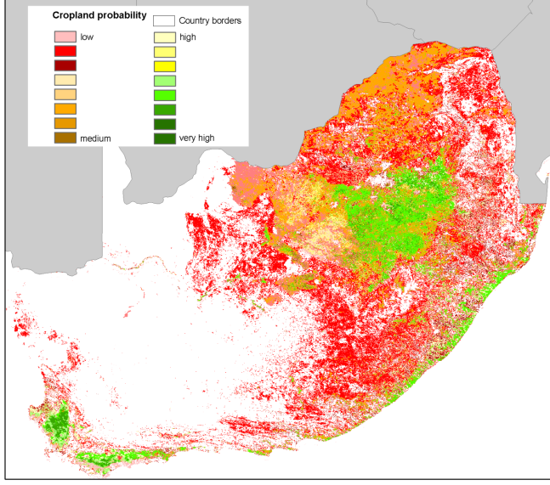
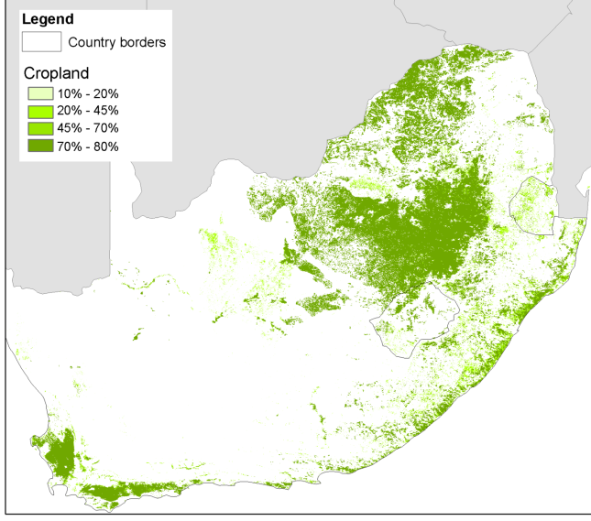
Cropland GLC-2000
Cropland GlobCover
Cropland MODIS
Crop Likelihood
Synergy map
Calibrated Cropland

Slide 42
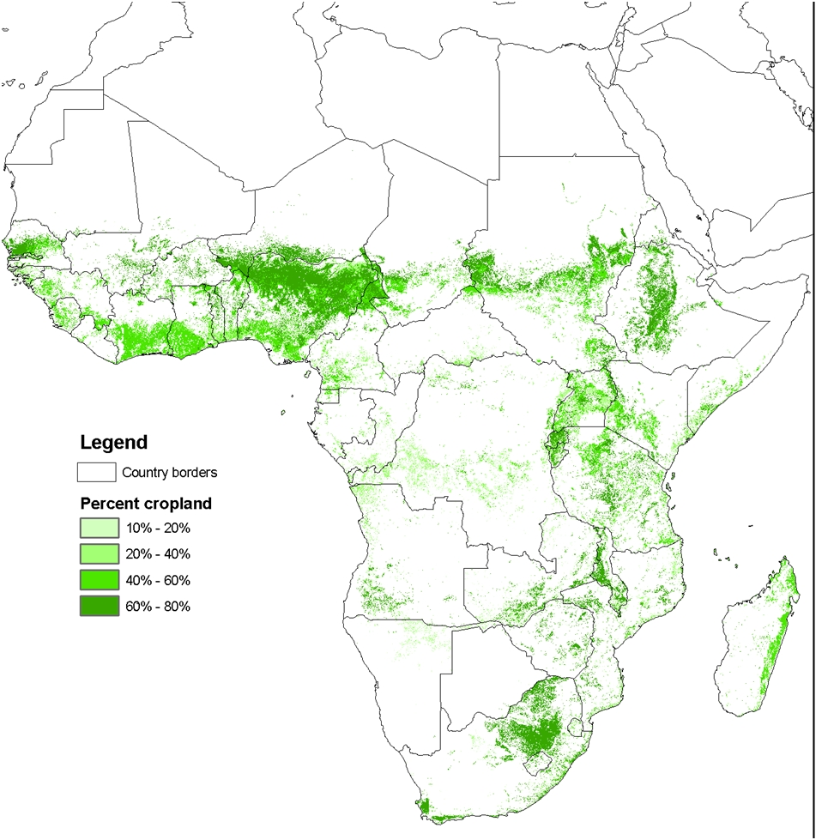
IIASA/ILRI map in Geo-Wiki
Available for download
Published in Fritz et al. (2011), GRL

Slide 43
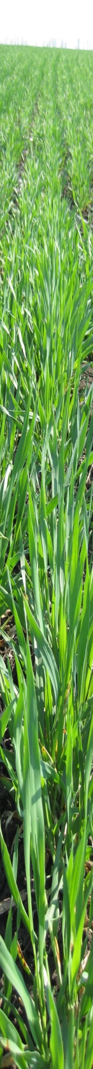
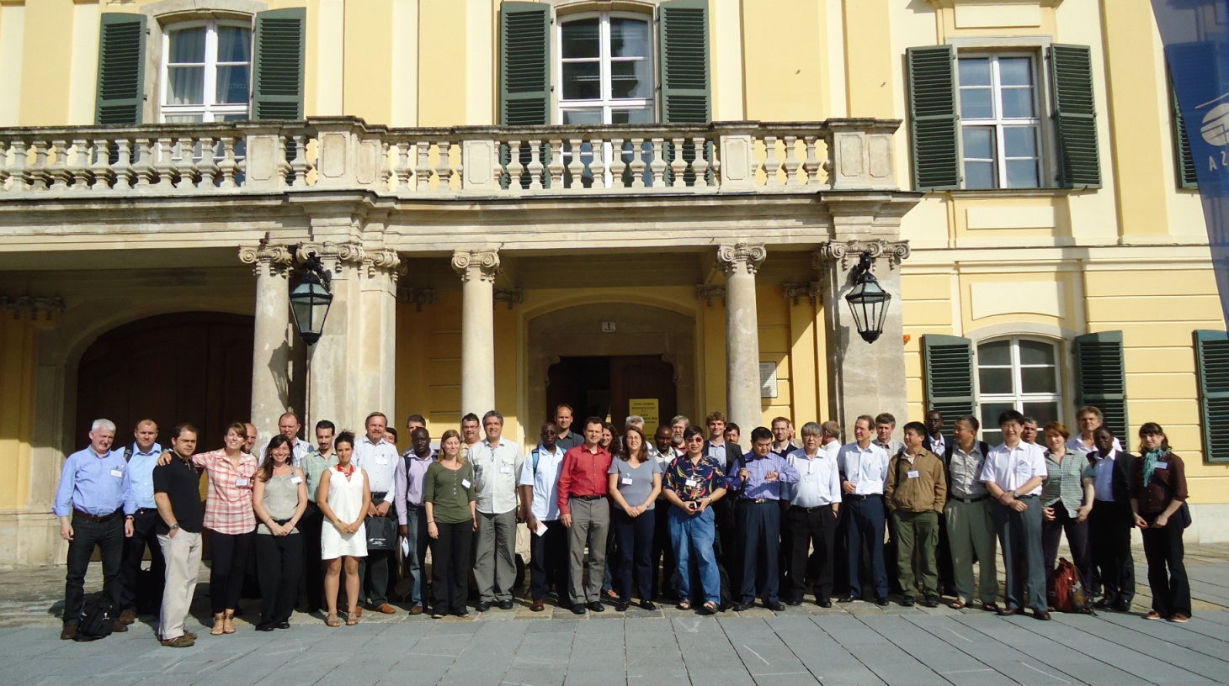
Land-useMap: An improved global land-use map
Land-useMap was initiated at the June 2011 IIASA workshop on Characterizing and Validating
Global Agricultural Landcover
Concept: collecting, harmonising and mapping global land-use and collecting in-situ data by establishing a network of national and global map producers and
land –use scientists
Lead: Steffen Fritz, Linda See (IIASA)
GOAL: to produce an improved land-use map and to collect in-situ data on land-use (crop type,
irrigated cropland, rangeland, plantation ec.)
Facilitate data sharing of already existing national, regional and global maps and in-situ data
Use advanced technologies (e.g. geo-wiki.org and smartphone applications) to visualise, collect and
share data and to incorporate expert knowledge.
Results from Land-useMap will help to:
  Improve agricultural monitoring
  Improve datasets used for integrated modelling studies
  improve decision making on sustainable development, food security and support climate policies

Slide 44
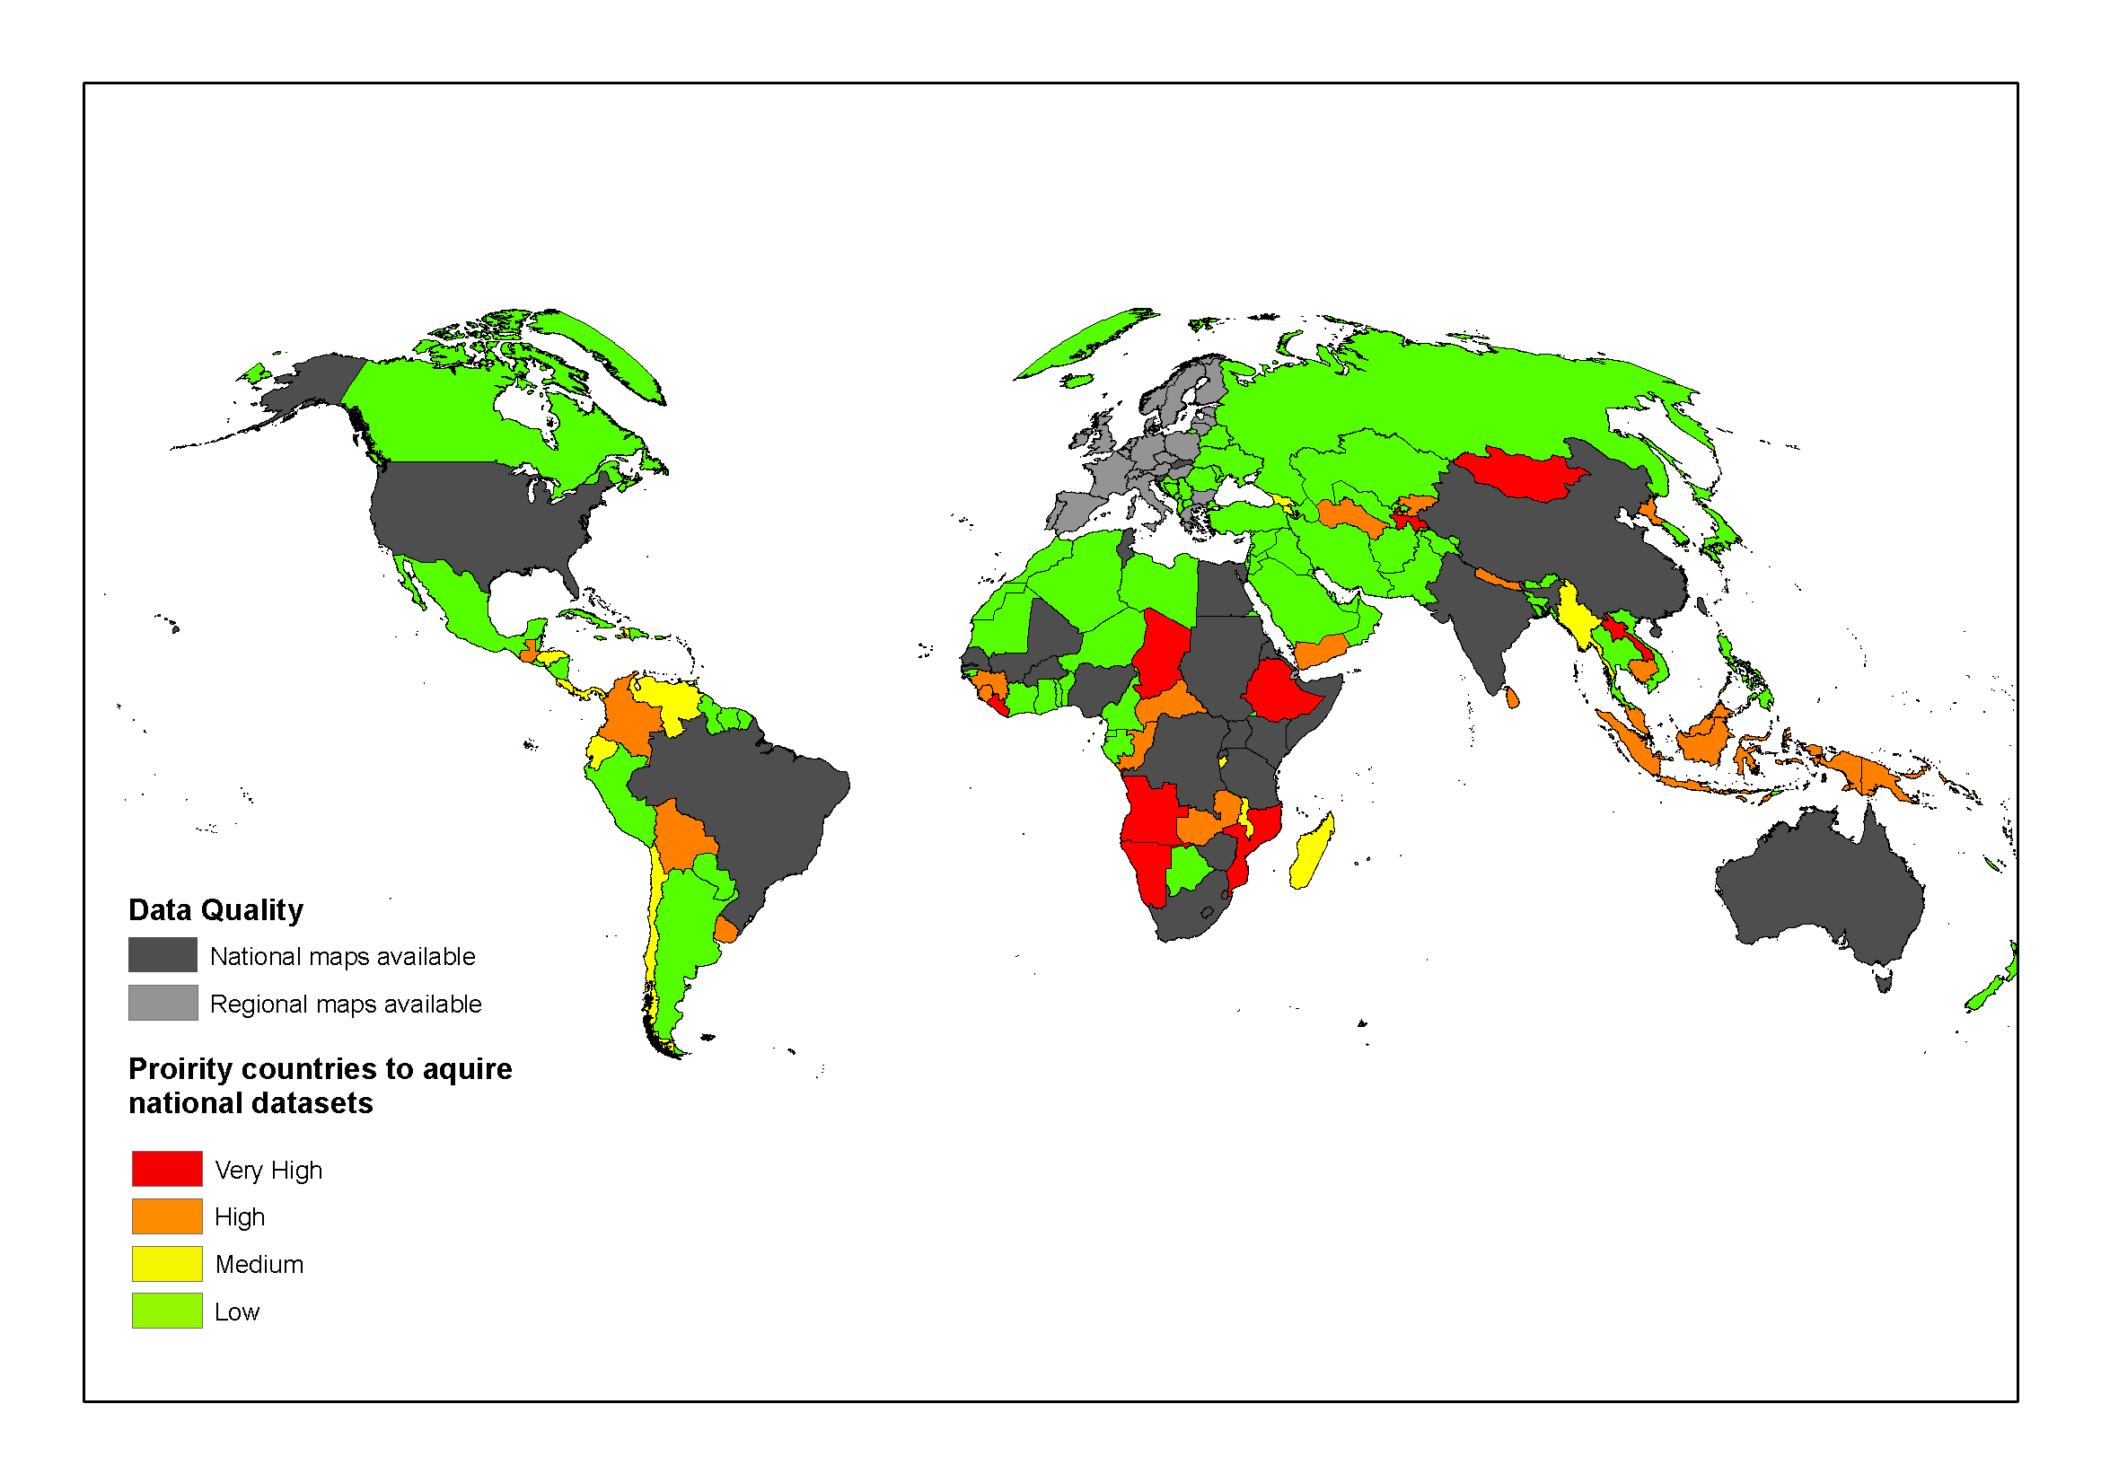

Slide 45
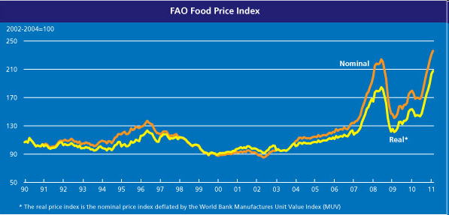
1. Background : The G20 Agriculture Priority (2011)
“ We, the G20 Agriculture Ministers, meet today to address the issue of food price volatility with the ultimate objective to improve food security and agree on an “Action Plan on food price volatility and agriculture” that will be submitted to our Leaders at their Summit in November 2011.”
(introduction of the “G20 Agriculture Action Plan”, June 2011)
At risk :
Access to food for populations
Investment in the agricultural sector (increase production by +70% over 2010- 2050)
45

Slide 46
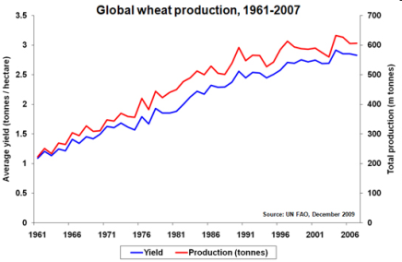
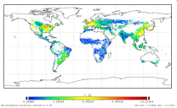
1. Background : The G20 Agriculture Priority (2011)
2 initiatives to increase information availability, quality and transparency
GEO-GLAM
Supply
Price
Demand
Policies
Finance
Trade
Stocks
AMIS
46

Slide 47
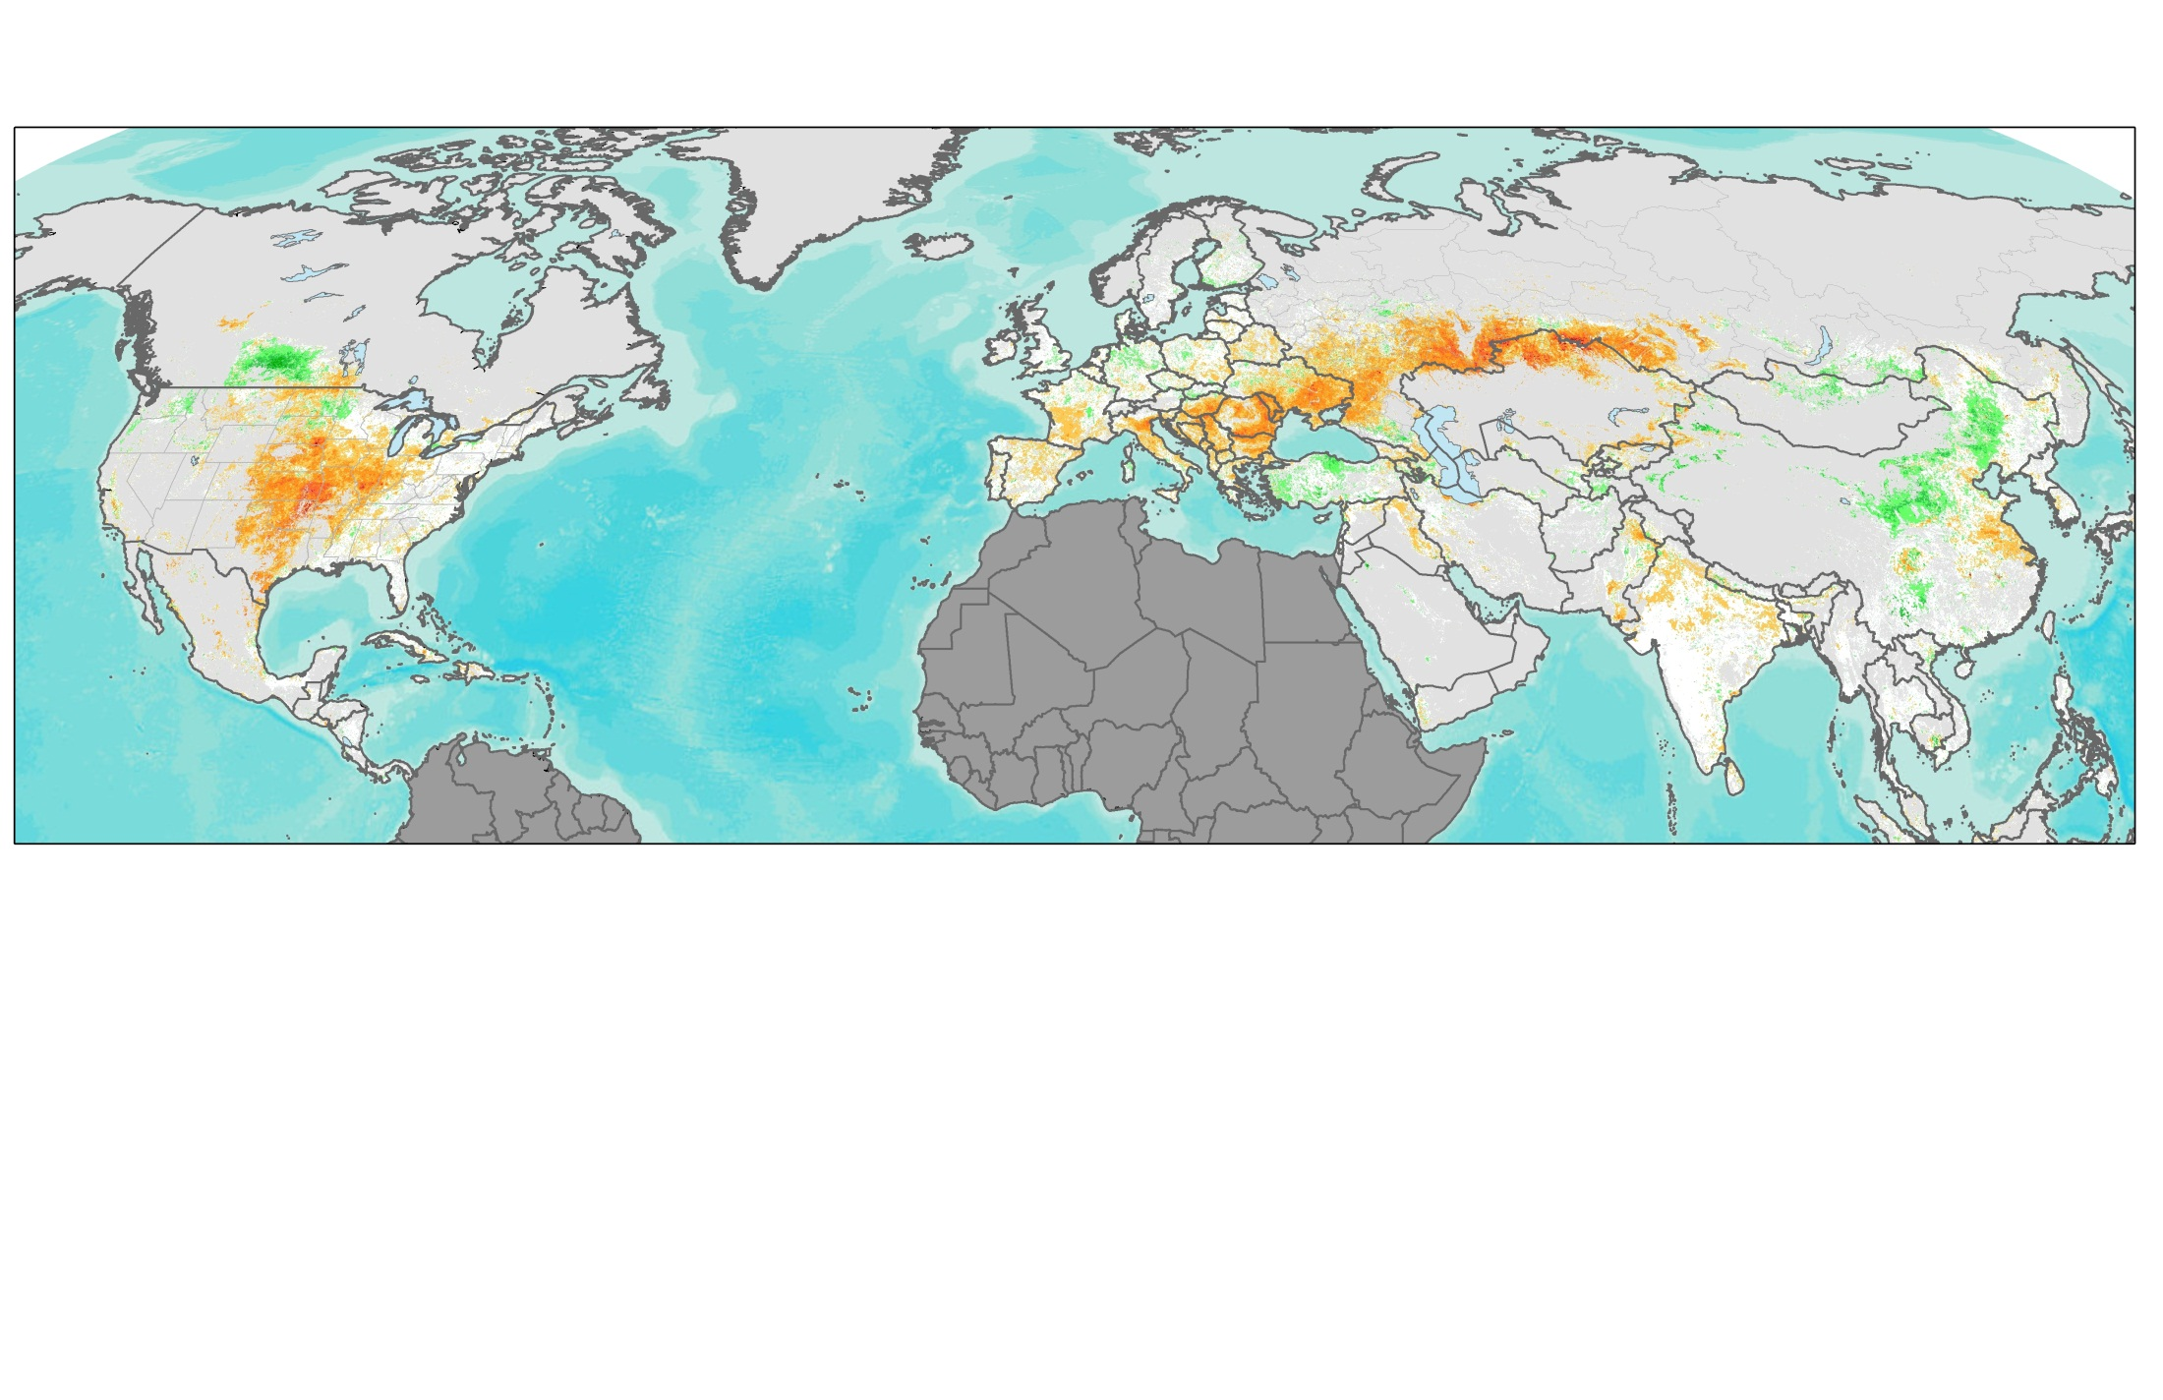

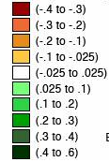
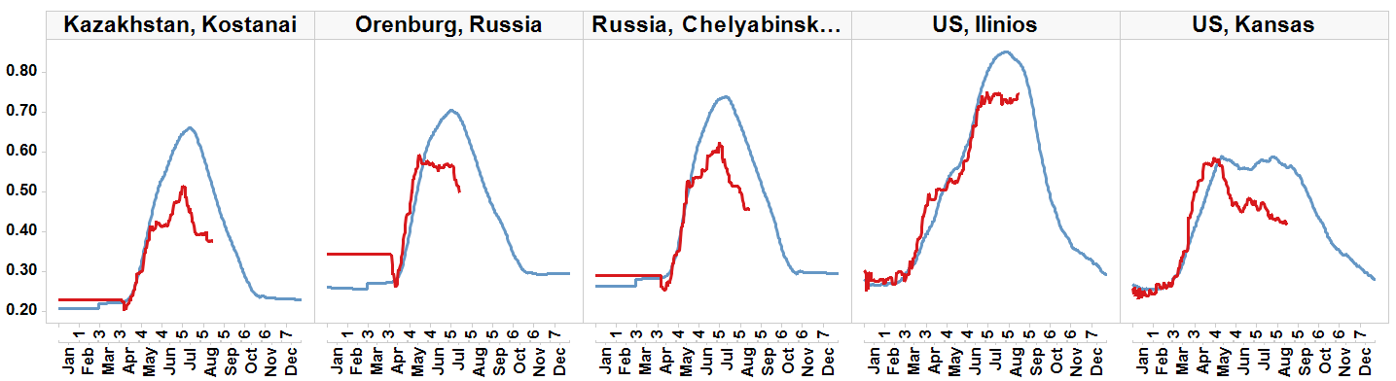

Current Conditions in Northern Hemisphere Crop NDVI Anomaly, August 13th, 2012
Canada
Russia
Ukraine
Kazakhstan
USA
China
Crop NDVI Anomaly
India
Non Cropland
Not shown
-0.4 0 0.4
Worse than normal
normal
Better than normal
Russia, Orenburg
Spring Wheat
Spring Wheat
Spring Wheat
Corn/
Soy
anomaly
Winter Wheat/ Corn
anomaly
anomaly
NDVI
anomaly
anomaly
Current season crop development (2012)
Average season development (2000-2011)

Slide 48

G20 Final Declaration
1. Background : The G20 Agriculture Priority (2011)
44. We commit to improve market information and transparency in order to make international markets for agricultural commodities more effective. To that end, we launched:
The "Agricultural Market Information System" (AMIS) in Rome on September 15, 2011, to improve information on markets ...;
The "Global Agricultural Geo-monitoring Initiative" (GEOGLAM) in Geneva on September 22-23, 2011. This initiative will coordinate satellite monitoring observation systems in different regions of the world in order to enhance crop production projections and weather forecasting data.
48

Slide 49
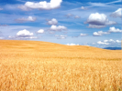
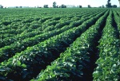


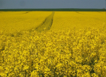
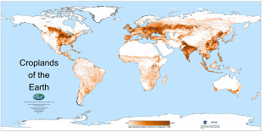

















The GEOGLAM Initiative : objectives
To reinforce the international community’s capacity to produce and disseminate relevant, timely and accurate forecasts of agricultural production at national, regional and global scales.
Agronomy
Agronomy
Agronomy
Agro
Agro
Agro
-
-
-
economy
economy
economy
Cultivated area / crop type area
Crop yield forecast
49

Slide 50
2. The GEO-GLAM Initiative : Components
Agricultural Expertise
Meteorological
Expertise and Info
Earth Observations
Satellite / Ground Data / Models
Operational Research and Development
Data/Techniques/Methods/Best Practices
1
2
3
Strengthening National
Capacity for Agricultural Monitoring
Enhancing
Global Agricultural Monitoring
Systems
Coordinated Satellite and In-Situ Earth
Observations
Improved information and reporting, and timely Dissemination Systems
Condition/Area/ Yield / Statistics
Public
Govts
AMIS
FAO Stat
50
Notes:
50

Slide 51
2. The GEO-GLAM Initiative : Deliverables
  Deliverable 1 : Access to Earth Observation data for agriculture monitoring
  Deliverable 2 : Access to Meteorological data and forecasts
  Deliverable 3 : Cultivated areas, crop-type distribution, crop yield forecasts
  Deliverable 4 : Improved monitoring methods
  Deliverable 5 : Strengthened national agricultural monitoring capacities
  Deliverable 6 : Dissemination of data to stakeholders;
  Deliverable 7 : A sustained Earth observation system of systems for agricultural monitoring.
51

Slide 52
2. The GEO-GLAM Initiative : Actors and agenda
Key actors of the Initiative :
  International entities : GEO, FAO, WMO, CGIAR, CEOS
  Operational actors : GEO Agriculture CoP⁺ members
  Regional and National organisations
  Private actors, NGOs
Phases and Budget :
  Preliminary Phase : Sept 11 – June 12 : international involvement, work plan, budget, governance scheme. securing funding
  Operational Phase : 2012-2017
2011
2012
2012
2013
2014
2015
2016
2017
Intercomparison of global products; JECAM; EO data access; Capacity building modules
52

Slide 53


Thank you !
© GEO Secretariat
53

Slide 54
Thank you!
Questions?
fritz@iiasa.ac.at

